Slide 1


The Transition to Modern Office Add-in Development
Presented by
Cameron Dwyer

Slide 2
Introduction
Office, Office 365 and extensibility
Developer opportunity
The OnePlaceMail story
Notes:
SP is the server MS gave us to store Office docs
Online versions of Office apps. Now more than even Office online now feels like it’s part of SP (viewing, editing, authoring)
For the majority – content in SP is Office docs | add-ins to extend capability | potential to benefit your SP users | more productive.

Slide 3
Outline
Recap on the existing add-in development model
Why a new model was needed
Explain the modern Office add-in model
What does this mean for Office developers
Beyond add-ins – the Office Developer Vision
Q & A
Notes:
This is an Outline of what we will cover tonight

Slide 4
The existing Office add-in model
COM Add-ins and/or Visual Studio Tools for Office Add-ins (VSTO)
Typically C# or VB (.Net Framework) written in Visual Studio
Add-ins were compiled code (dll’s)
Dll’s were deployed (installed) onto machines running Office client via setup packages or .msi files
Rich extensibility experience - customize ribbon, areas of the host application, context menus, events, deep APIs into the data/content (e.g. Excel API)
Access to local machine resources
Experience “on rails”
Notes:
On Rails – There was one way to develop, vary from it and it didn’t work. Limited choices in technology or approach.
Code is compiled (DLL + other resource files) then packaged, then installed on the client machine before it can execute.

Slide 5
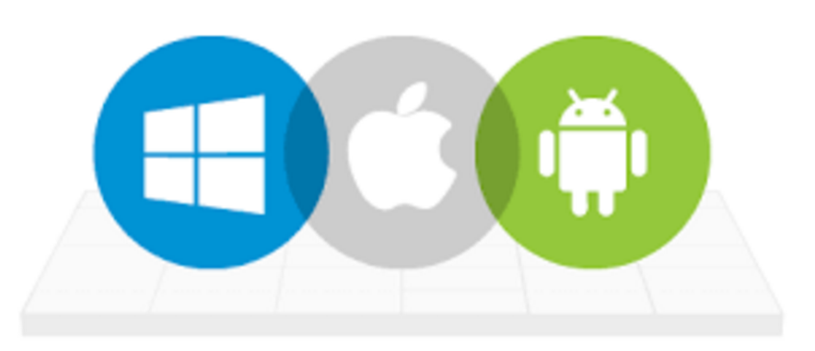
Why did we need a new model?
Office is now on any device (Windows, Mac, iOS, Android and Office Online)
Those compiled DLLs would only ever work on a Windows PC
We needed an extensibility model to match, one that could work on any device
Microsoft struggled in 2 other areas under the old model:
Add-in code isolation (performance, stability)
Deployment
Notes:
Add-in code isolation
Poor add-in code could slow down the host app and make it unresponsive
Poor add-in code could crash the host app and make it unstable
Deployment
Was complex

Slide 6
The modern Office add-in model
Designed to interact with data in a document, workbook or mail item (same as old model)
Designed to develop once and run in Office across all platforms and devices *
The add-in is essentially a web application that can be hosted anywhere
Develop using standard web technologies (HTML, CSS, JavaScript)
Code does not get installed on end user devices
The add-in is displayed in pre-defined locations/contexts within the host Office application
Notes:
The runtime that is common across all those devices is web browser capability of executing JavaScript and rendering HTML and CSS
Frames in the host app - allows code isolation. Code can’t see outside of it’s frame. Stability for host.

Slide 7
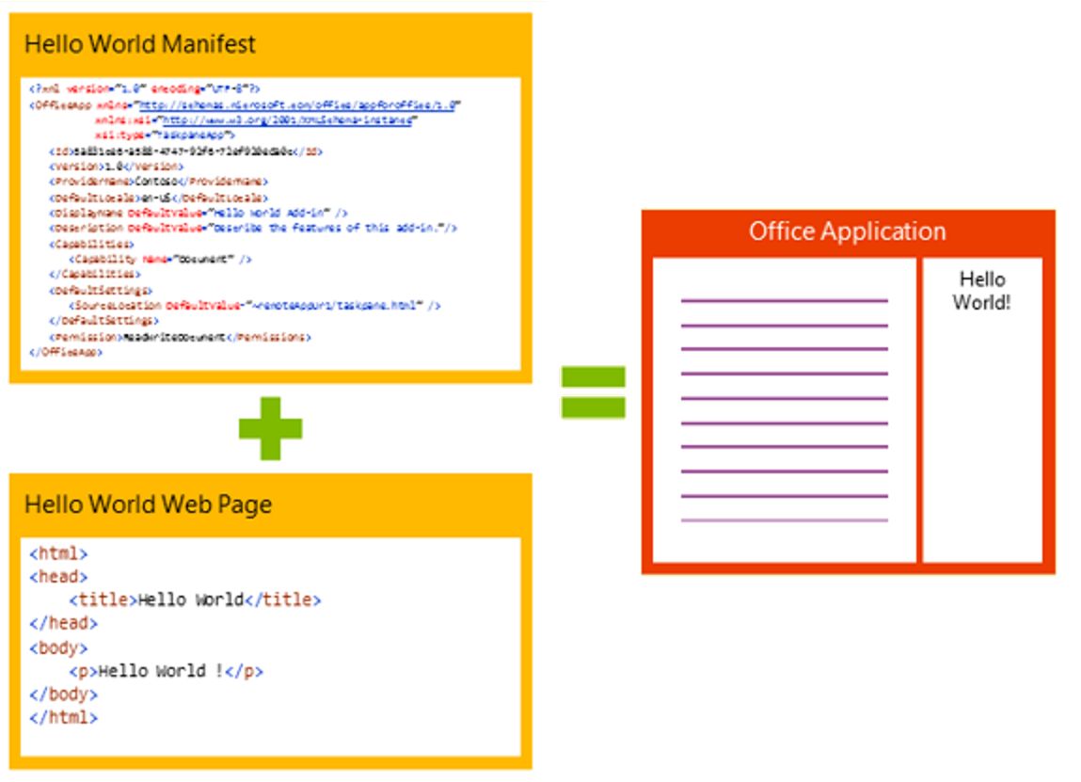
Anatomy of an add-in
Notes:
What makes up an add-in
2 critical pieces
Manifest = xml to describe the addin (title, description, where/when the add-in will show itself)
e.g. Hello World. Office App can startup and show add-in buttons without executing any add-in code
HTML Page = Manifest points to this and this is what gets loaded into the “frame” in the Office app

Slide 8
Add-in contexts
Task pane add-in
Add-in that runs beside a document/mail with read/write access
Word, Excel, PowerPoint, Project, Outlook
Content add-in
Add-in that runs within a document content with read/write access
Excel, PowerPoint, Access
Add-in command
Command in the Office UI to launch add-in or perform UI-less operation
Outlook and Outlook Web Access (OWA)

Slide 9
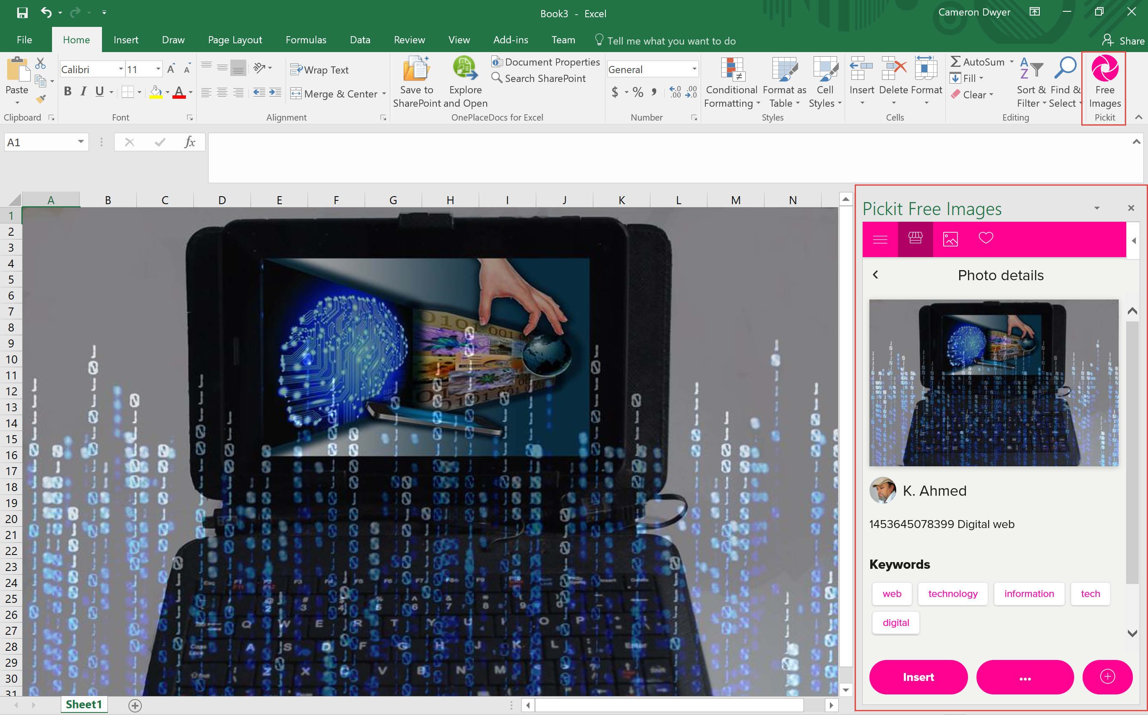
Task Pane add-ins [Demo]
Notes:
Task Pane Context
Enable users to interact with your solution.
These usually make sense when the add-in is performing operations on the current document
Manipulate or interact with the document.

Slide 10
Add-in contexts
Task pane add-in
Add-in that runs beside a document/mail with read/write access
Word, Excel, PowerPoint, Project, Outlook
Content add-in
Add-in that runs within a document content with read/write access
Excel, PowerPoint, Access
Add-in command
Command in the Office UI to launch add-in or perform UI-less operation
Outlook and Outlook Web Access (OWA)

Slide 11
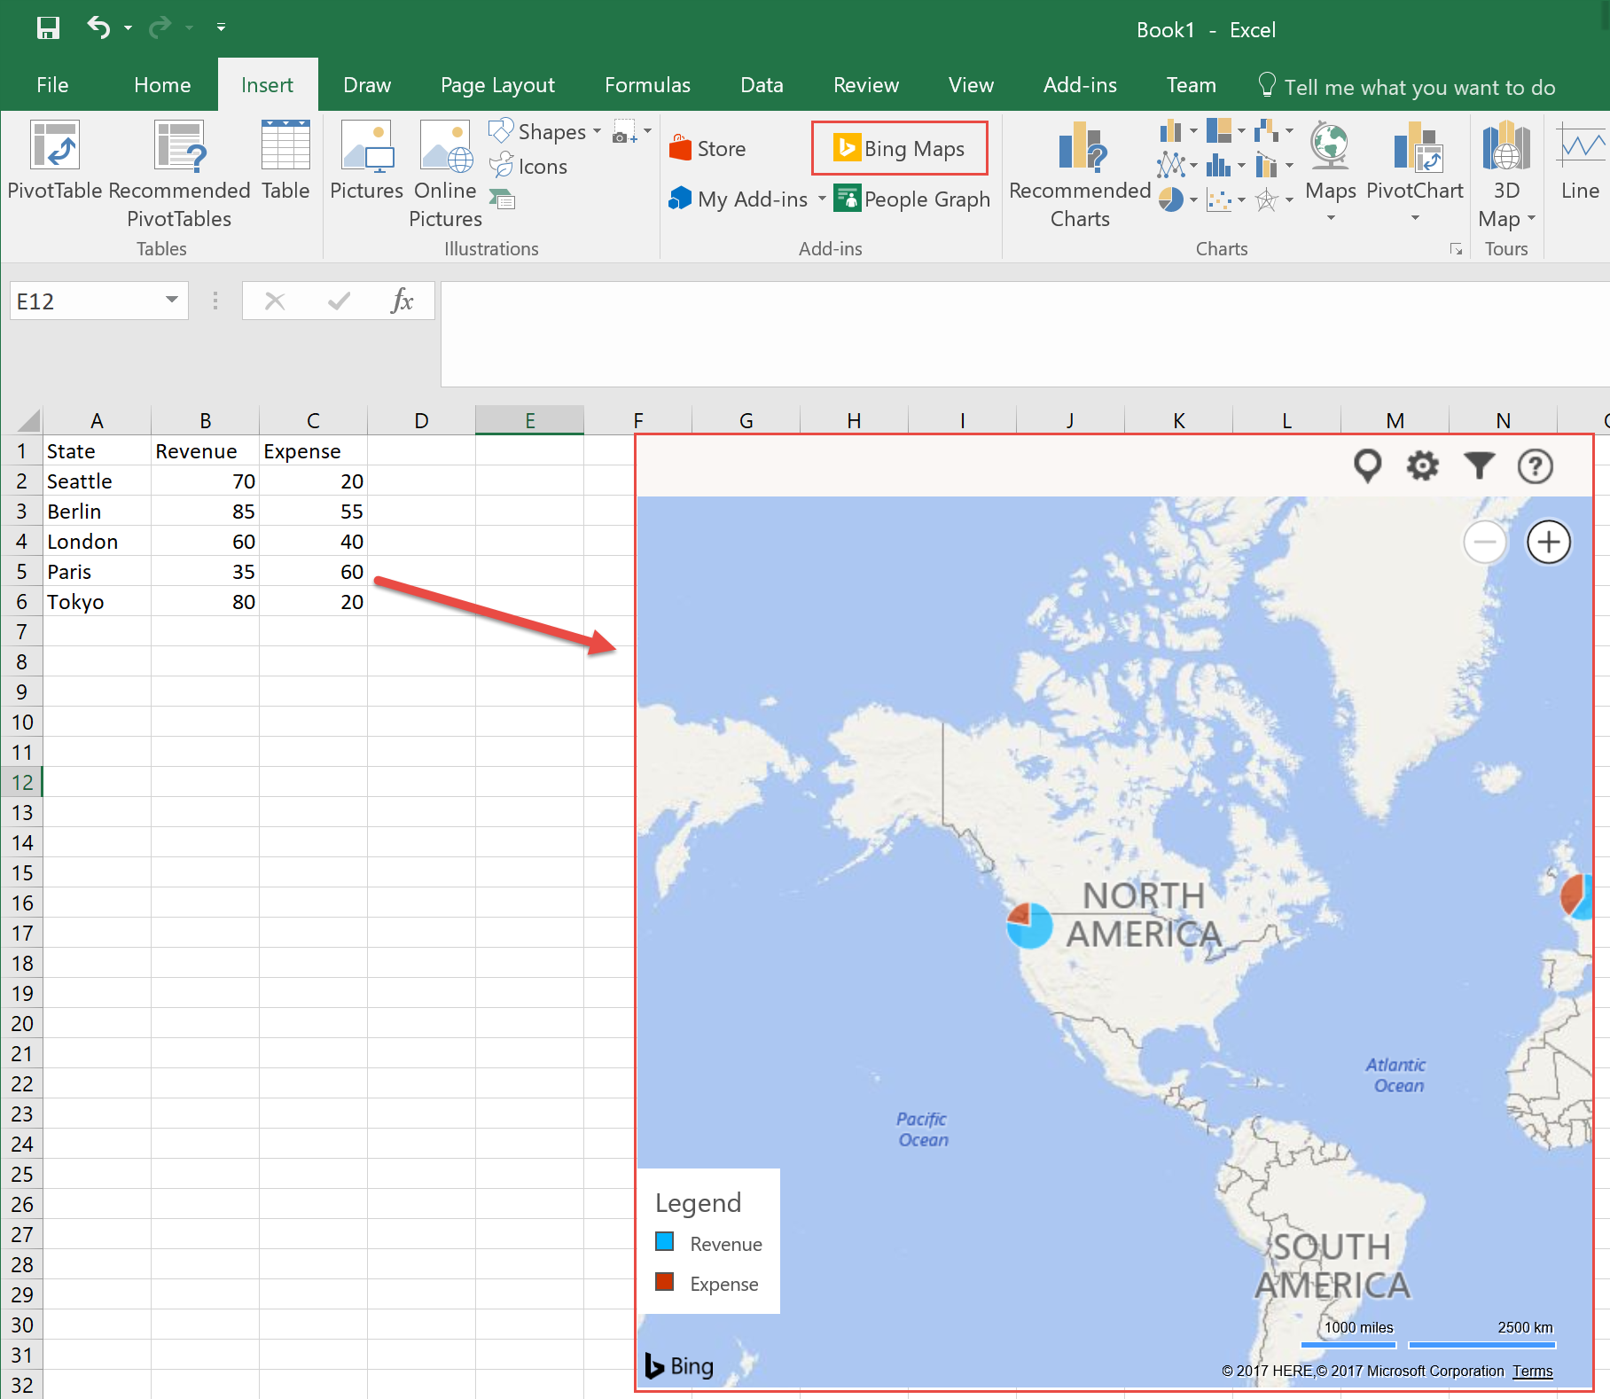
Content add-ins [Demo]
Notes:
Demo the Bing Maps add-in in Excel
Custom content embedded within the document

Slide 12
Add-in contexts
Task pane add-in
Add-in that runs beside a document/mail with read/write access
Word, Excel, PowerPoint, Project, Outlook
Content add-in
Add-in that runs within a document content with read/write access
Excel, PowerPoint, Access
Add-in command
Command in the Office UI to launch add-in or perform UI-less operation
Outlook and Outlook Web Access (OWA)

Slide 13
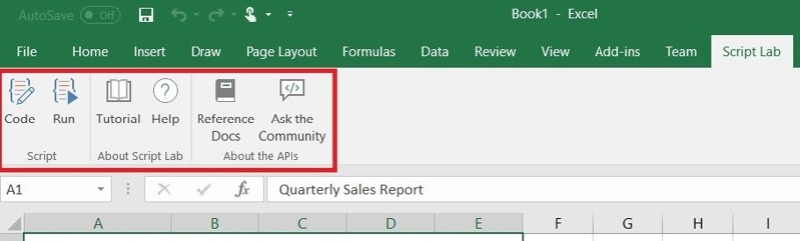
Add-in commands [Demo]
Notes:
Script lab demo (Excel | Insert tab | Store | Education | Script Lab)
Custom ribbon buttons
Can launch show a task pane with custom HTML page
OR
Pop up a dialog with a custom HTML page
OR
Execute a JavaScript function

Slide 14
Office.js – the JavaScript API for Office
Office.js is the new Office API
This is a JavaScript library that you can include in the web page of your add-in
Provides access to the object models of host Office application (including current document or item)
Office.js dynamically loads in Common APIs (apply to all Office applications) and host specific APIs (such as the Word API or Excel API)
This provides strongly types object models
This allows your add-in to interact with the Office app
Microsoft iterating quickly on these APIs to remove barriers in converting VSTO add-ins
Notes:
So if the add-in is technically a web page (web app) hosted within the Office app
How does the your add-in page interact with Office?
This provides an API that can be used across devices and operating environments

Slide 15
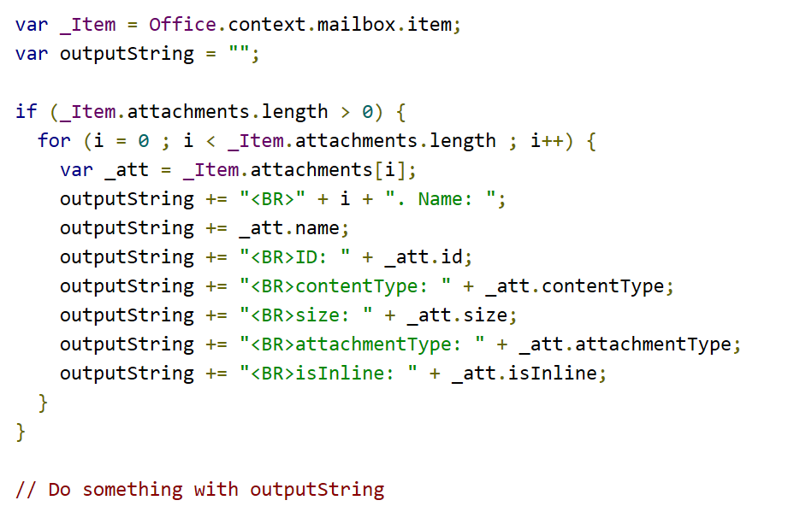
Example Office.js code
Notes:
Get handle on the mail item current selected in the mail box
Loop through all the attachments and build up a string of each attachments properties

Slide 16
Deployment
Add-ins can be acquired through the Office store
Enterprise add-ins can be made available using a private add-in catalog
No code to install on user machines/devices
No elevated permissions needed
Install on one host installs on all hosts
Centralized deployment controls for organisations
Deployment is the act of associating an add-in manifest with a user
Notes:
The manifest.xml tells the host Office app how and when to surface the actions to start the add-in
When the add-in is started the HTML page for the add-in is loaded into the context defined by the manifest xml

Slide 17
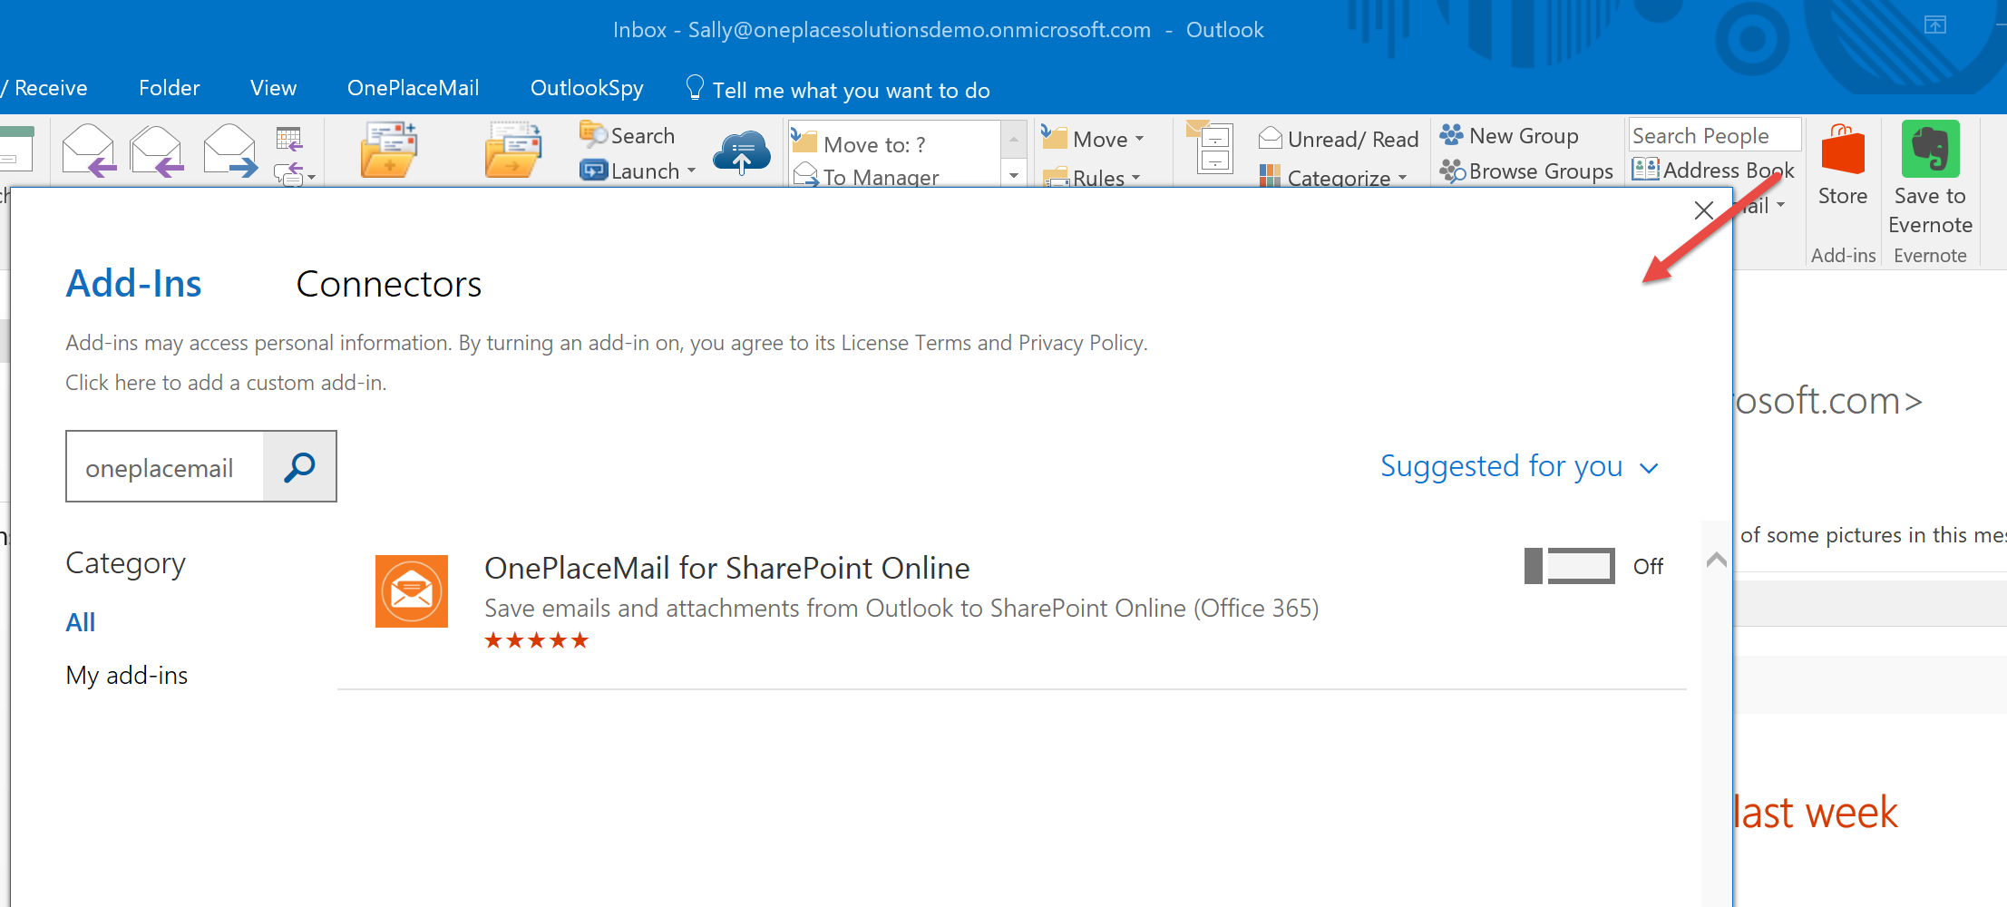
Deployment from Office Store [Demo]
Notes:
Give OnePlaceMail demo once it’s installed
Demo flows into different UX on different hosts (gives context to the app)
Also flow back into SharePoint and Office 365 APIs

Slide 18
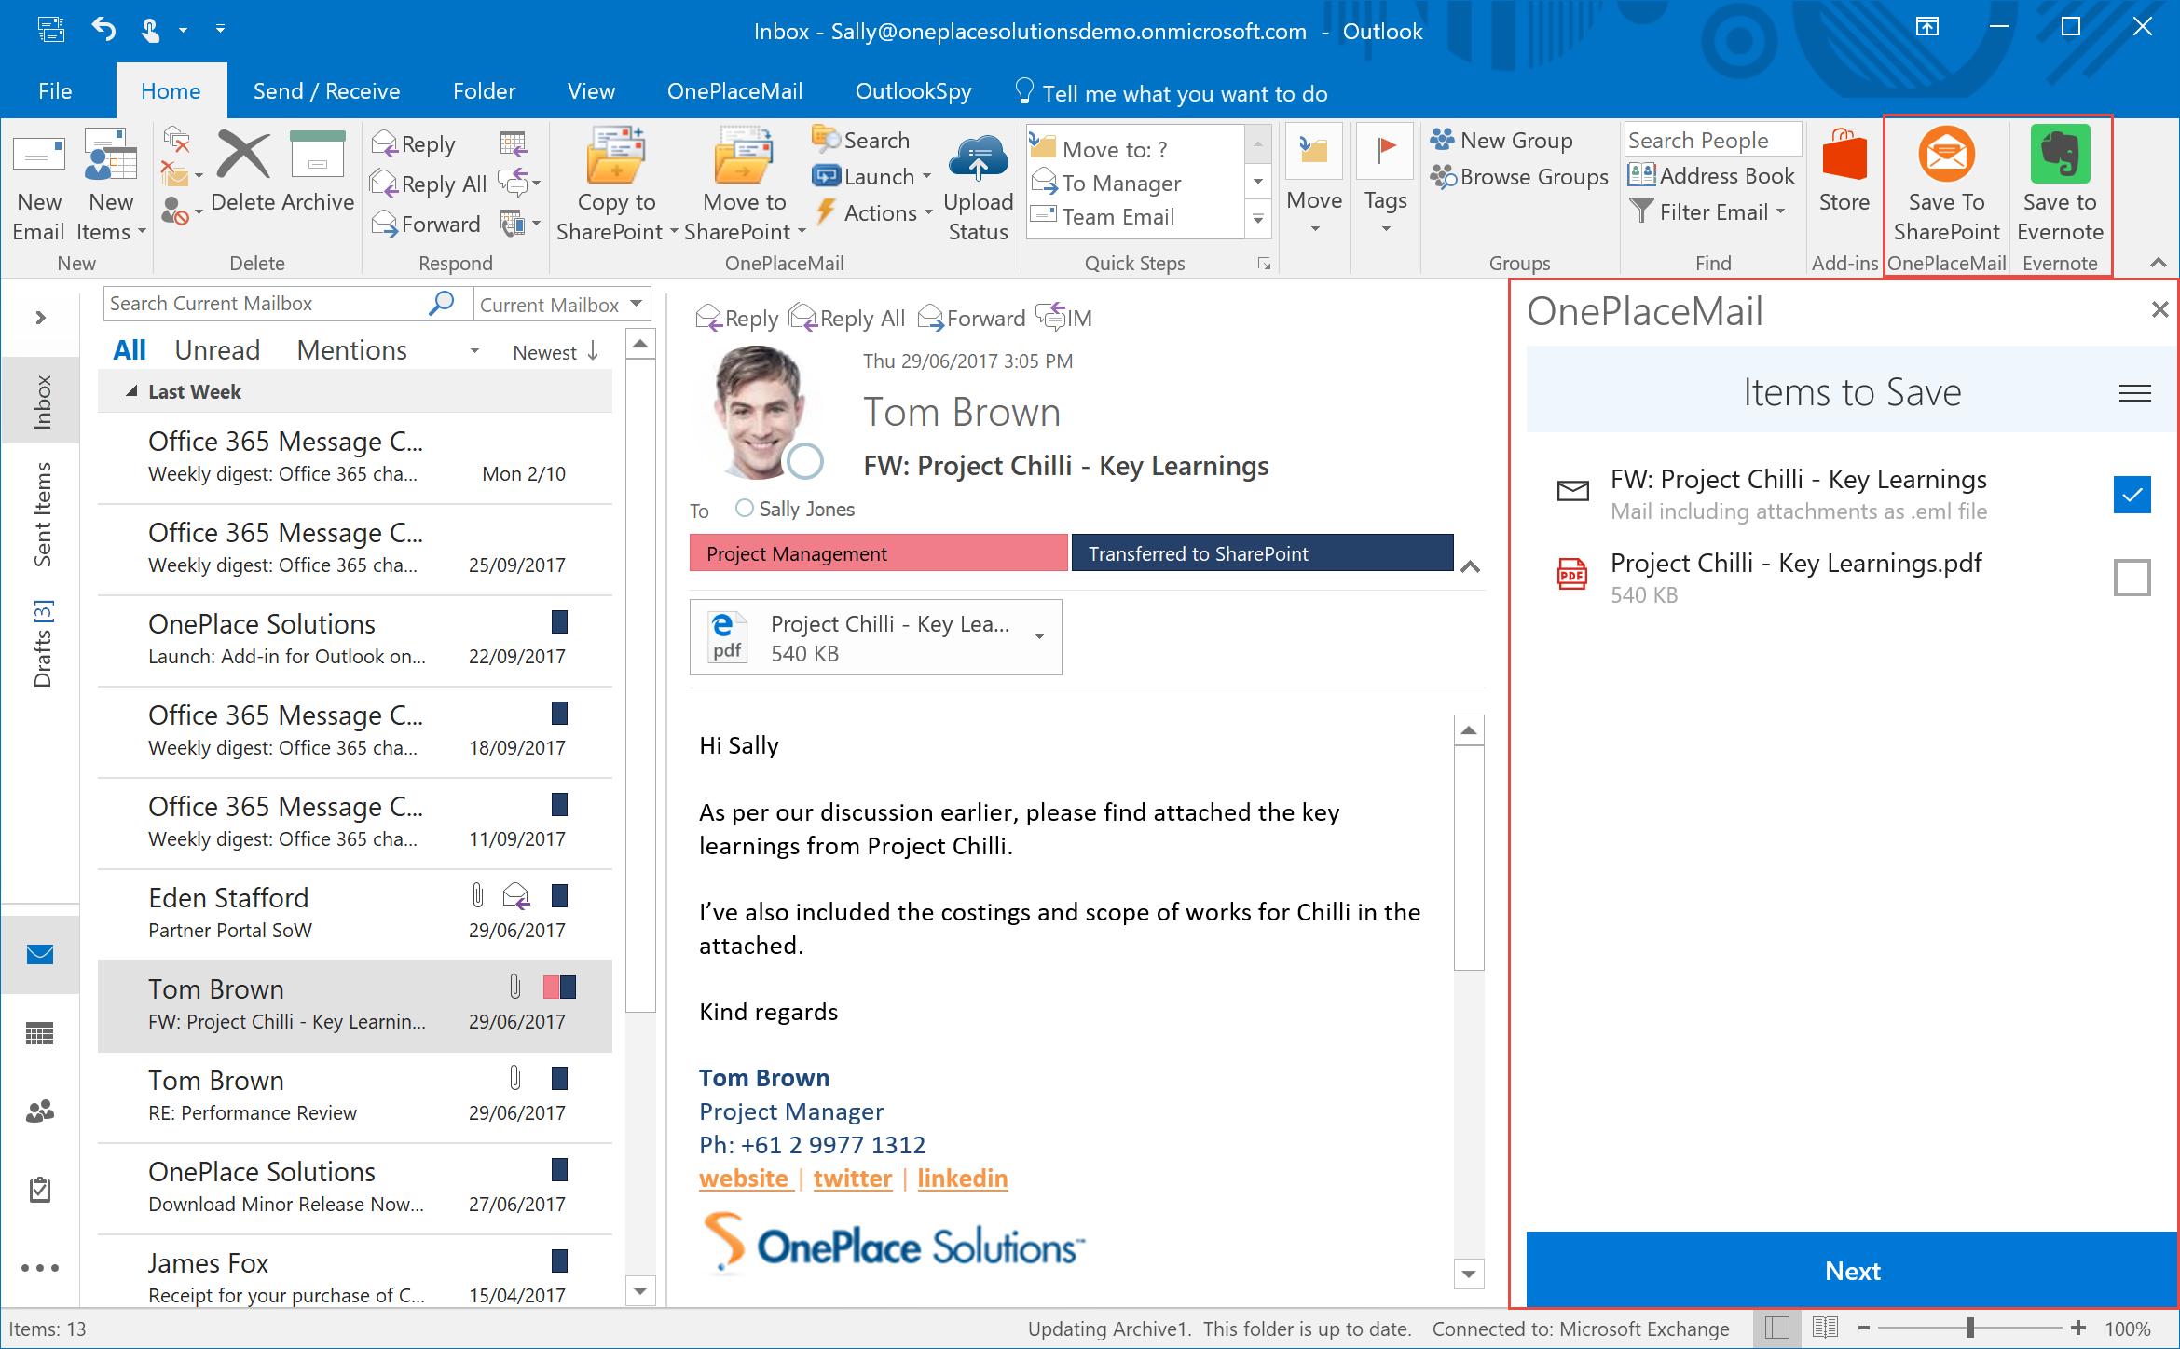
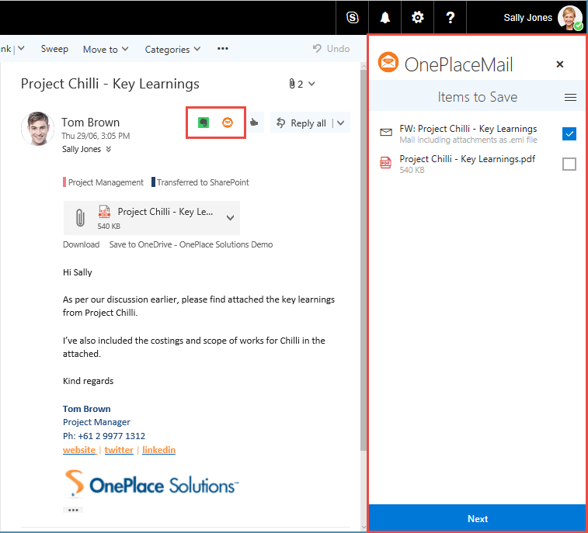
Different Hosts
Different UX
Notes:
Task pane example
[BACK] Desktop Outlook on Windows, [FRONT] Outlook Web Access
Cross device the UX is different
Displays differently – no ribbon, add-ins launched from within the email content
Task pane is resizable in desktop Outlook
Task pane header looks different (notice the Logo)

Slide 19
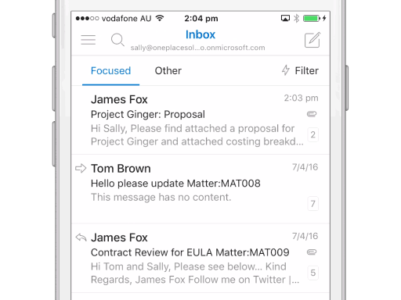
Different Hosts
Different UX

Slide 20
Modern add-in advantages over VSTO
Cross-platform support. Runs in Office for Windows, Mac, iOS, Android and Office Online.
Centralized deployment and distribution. No code installed on end user machines.
Add-ins do not affect the performance and stability of the host application.
The application is evergreen, because it's centrally hosted making a change to the web app makes it available to all users immediately. Everyone is on the same version.
Based on standard web technology. No tie in to using Microsoft stack for developing it.
Notes:
The extensibility points have been created in such a way to ensure that they cannot affect the performance of the host application and cannot make the host application unstable.
Far easier to deploy
You can use any library you like to build Office Add-ins.

Slide 21
What does this mean for Office developers?
Old model was on rails (Visual Studio, C#/VB, .Net Framework, VSTO)
New model is web standards (HTML, CSS, JavaScript)
You are essentially a web developer = power, freedom, confusion and maybe paralysis
Develop on Windows, Mac or Linux (Visual Studio code work on all of these)
HTML, CSS & JavaScript by themselves are difficult to scale when building Enterprise apps
Use JavaScript frameworks (Angular, React)
Use TypeScript instead of JavaScript (strongly typed)
But this is only part of the developer story……
Notes:
Writing maintainable scalable apps in JavaScript takes a lot of discipline. Use a framework instead.
Angular & React give patterns to allow you to scale the application with classes and modules similar to existing C#/.Net Framework development.
Without framework you would cobble together functionality yourself or combine several available JS libraries,
TypeScript (strongly typed, compiled to JavaScript, cross-browser JavaScript, a bit future proof – can compile to a newer version of JavaScript).

Slide 22
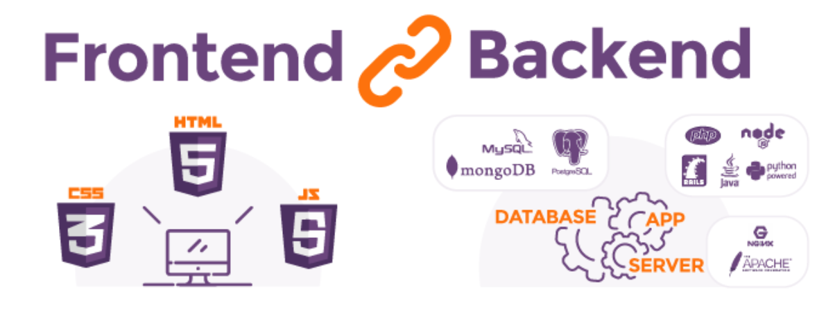
The Full Stack Developer
Most add-ins consist of a front-end AND a back-end
Front-end (Presentation layer - HTML, CSS, JavaScript) – runs on the users device in a browser
Back-end (Business logic and data layers) – runs on your server or hosted environment
Notes:
Backend – traditional ASP.Net app spans both Front-end and Back-end
You are free to do backend however you want
So now it entirely possible to do front-end and back-end in non-Microsoft technologies

Slide 23



OnePlaceMail Stack
Alternatives
Framework: Angular (SPA)
Language: TypeScript
UI: Office UI Fabric, CSS
IDE: Visual Studio Code
React, Aurelia
JavaScript
Bootstrap, Kendo UI, LESS, SAAS
Visual Studio, Sublime Text, Atom, WebStorm
Front-end
.Net Web API (C#)
Hosting: Azure Web App
IDE: Visual Studio
Node.js, Python, PHP, Azure Functions, AWS Lambda
IIS, Apache, Serverless (Azure, AWS)
Huge array of options (depends on language/tech)
Back-end
Office 365 (SharePoint)
SQL, Azure (CosmosDB, Blob, Table, Queues), MySQL, PostGres, Mongo DB
Data Storage
Notes:
IDE = Integrated Development Environments
Talk about Office UI Fabric -assist in making the add-in look like a natural extension of Office
What does your build, debug, deploy pipeline look like?
Tools - Task runners (Gulp, Grunt, NPM scripts), local light weight servers for debug, scripted deployment.

Slide 24


Beyond add-ins
The Office Developer Vision
USERS
DATA
Notes:
Users: Changing the UX within MS applications Enhance the user experience (Add-ins form a big part of this)
Data: Provide access to user’s data stored in Office 365 (this includes SharePoint)
FROM YOUR OWN Standalone apps, Native device apps – NOT Office add-ins.
This presentation has covered a the User side of the Office dev story
We don’t have time to dive into the Data side to far but I wanted to give an awareness
Modern Office developer is both sides

Slide 25
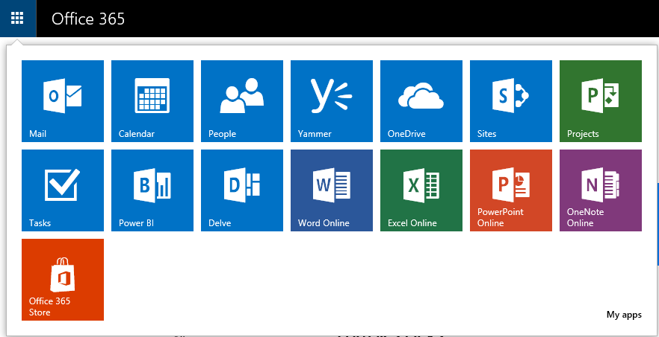
Office 365 Services
Notes:
Office 365 brings together (in the cloud) what used to be separate server products (also some new ones that never existed)
Each of these services historically had their own API (e.g. SharePoint, OneDrive, Exchange for Mail and Calendar, Active Directory for people and groups)

Slide 26
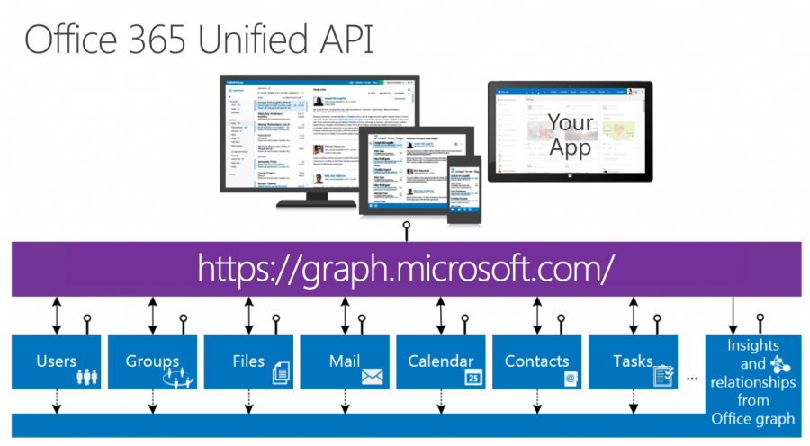
Microsoft Graph
https://graph.microsoft.com/v1.0/me/messages
https://graph.microsoft.com/v1.0/me/manager
https://graph.microsoft.com/v1.0/sites/root/sites
https://graph.microsoft.com/v1.0/sites/root/lists/d7689e2b-941a-4cd3-bb24-55cddee54294/items?$filter=fields/Title eq 'Contoso Home’
https://graph.microsoft.com/v1.0/groups/02bd9fd6-8f93-4758-87c3-1fb73740a315/conversations
Notes:
Single Unified API across Microsoft services (SharePoint, OneDrive, Mail, Calendar, Active Directory)
One API to rule them all
Allows for easy traversal of objects and relationships
Consistent object models and patterns
** SHAREPOINT is now in the graph and gone GA at Ignite (sites, lists, list items)
Simplifies token acquisition and management (single authentication and consent model) – MSAL & ADAL libraries to help with this
O365 ONLY!!! The add-ins work without needing to be in Office 365, the Graph requires O365.

Slide 27
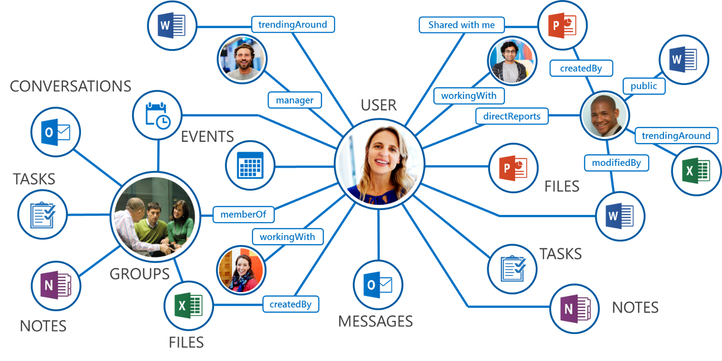
Microsoft Graph
Insights
https://graph.microsoft.com/beta/me/insights/trending
https://graph.microsoft.com/beta/me/insights/used
Notes:
Insights and relationships – only possible now MS has the power of the cloud
Machine learning
Used to be called the Office Graph (now Insights)
Relationships between people, events, items
Insights – trending, people I work with

Slide 28
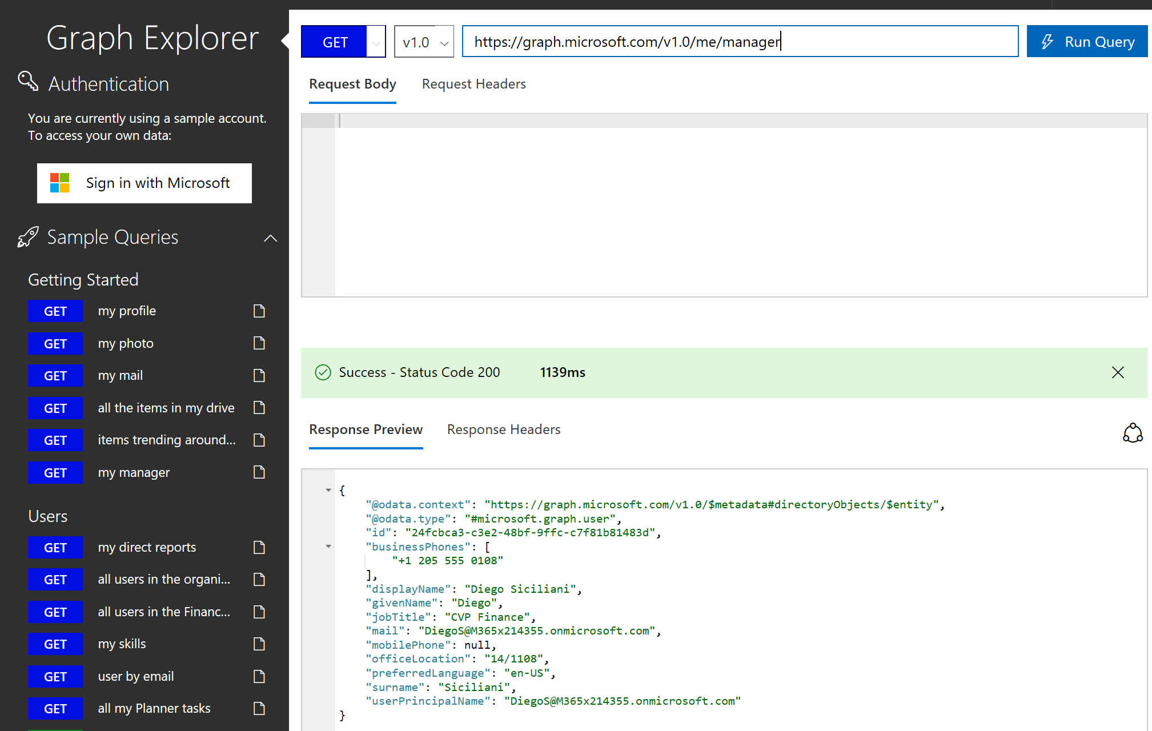
Microsoft Graph Explorer [Demo]
https://developer.microsoft.com/en-us/graph/graph-explorer

Slide 29
Summary
Office is now available on any device
The extensibility story has transitioned to match
This is a big shift for traditional Microsoft developers
There is much more choice for development technology and tooling
Key challenge is in understanding the different technologies and choosing wisely

Slide 30
Resources
https://dev.office.com/getting-started
https://dev.office.com/code-samples
https://developer.microsoft.com/en-us/graph/graph-explorer
https://developer.microsoft.com/en-us/fabric
https://angular.io/
https://reactjs.org/
https://www.oneplacesolutions.com/

Slide 31




Q & A
@CameronDwyer
camerondwyer.wordpress.com
www.linkedin.com/in/camerondwyer
www.oneplacesolutions.com

