Slide 1


The Transition to Modern Office Add-in Development
Presented by
Cameron Dwyer

Slide 2
Introduction
Office Add-ins and extensibility
Developer opportunity
The OnePlaceMail story

Slide 3
Outline
Recap on the existing add-in development model
Why a new model was needed
Explain the modern Office add-in model
What does this mean for Office developers
Q & A

Slide 4
The existing Office add-in model
COM Add-ins and/or Visual Studio Tools for Office Add-ins (VSTO)
Typically C# or VB (.Net Framework) written in Visual Studio
Add-ins were compiled code (dll’s)
Dll’s were deployed (installed) onto machines running Office client via setup packages or .msi files
Rich extensibility experience - customize ribbon, areas of the host application, context menus, events, deep APIs into the data/content (e.g. Excel API)
Access to local machine resources
Experience “on rails”

Slide 5

Why did we need a new model?
Office is now on any device (Windows, Mac, iOS, Android and Office Online)
Those compiled DLLs would only ever work on a Windows PC
We needed an extensibility model to match, one that could work on any device
Microsoft struggled in 2 other areas under the old model:
Add-in code isolation (performance, stability)
Deployment

Slide 6
The modern Office add-in model
Designed to interact with data in a document, workbook or mail item (same as old model)
Designed to develop once and run in Office across all platforms and devices *
The add-in is essentially a web application that can be hosted anywhere
Develop using standard web technologies (HTML, CSS, JavaScript)
Code does not get installed on end user devices
The add-in is displayed in pre-defined locations/contexts within the host Office application

Slide 7
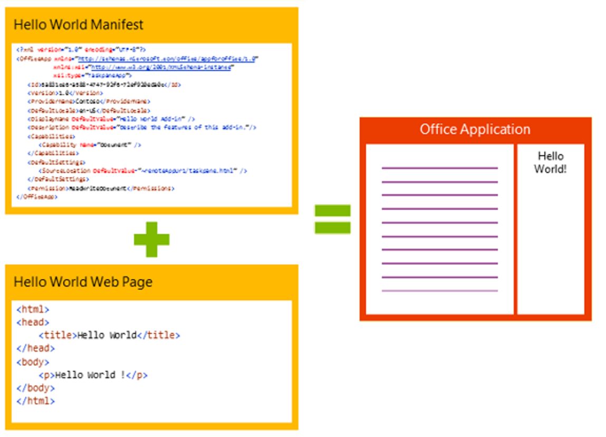
Anatomy of an add-in

Slide 8
Add-in contexts
Task pane add-in
Add-in that runs beside a document/mail with read/write access
Word, Excel, PowerPoint, Project, Outlook
Content add-in
Add-in that runs within a document content with read/write access
Excel, PowerPoint, Access
Add-in command
Command in the Office UI to launch add-in or perform UI-less operation
Outlook and Outlook Web Access (OWA)

Slide 9
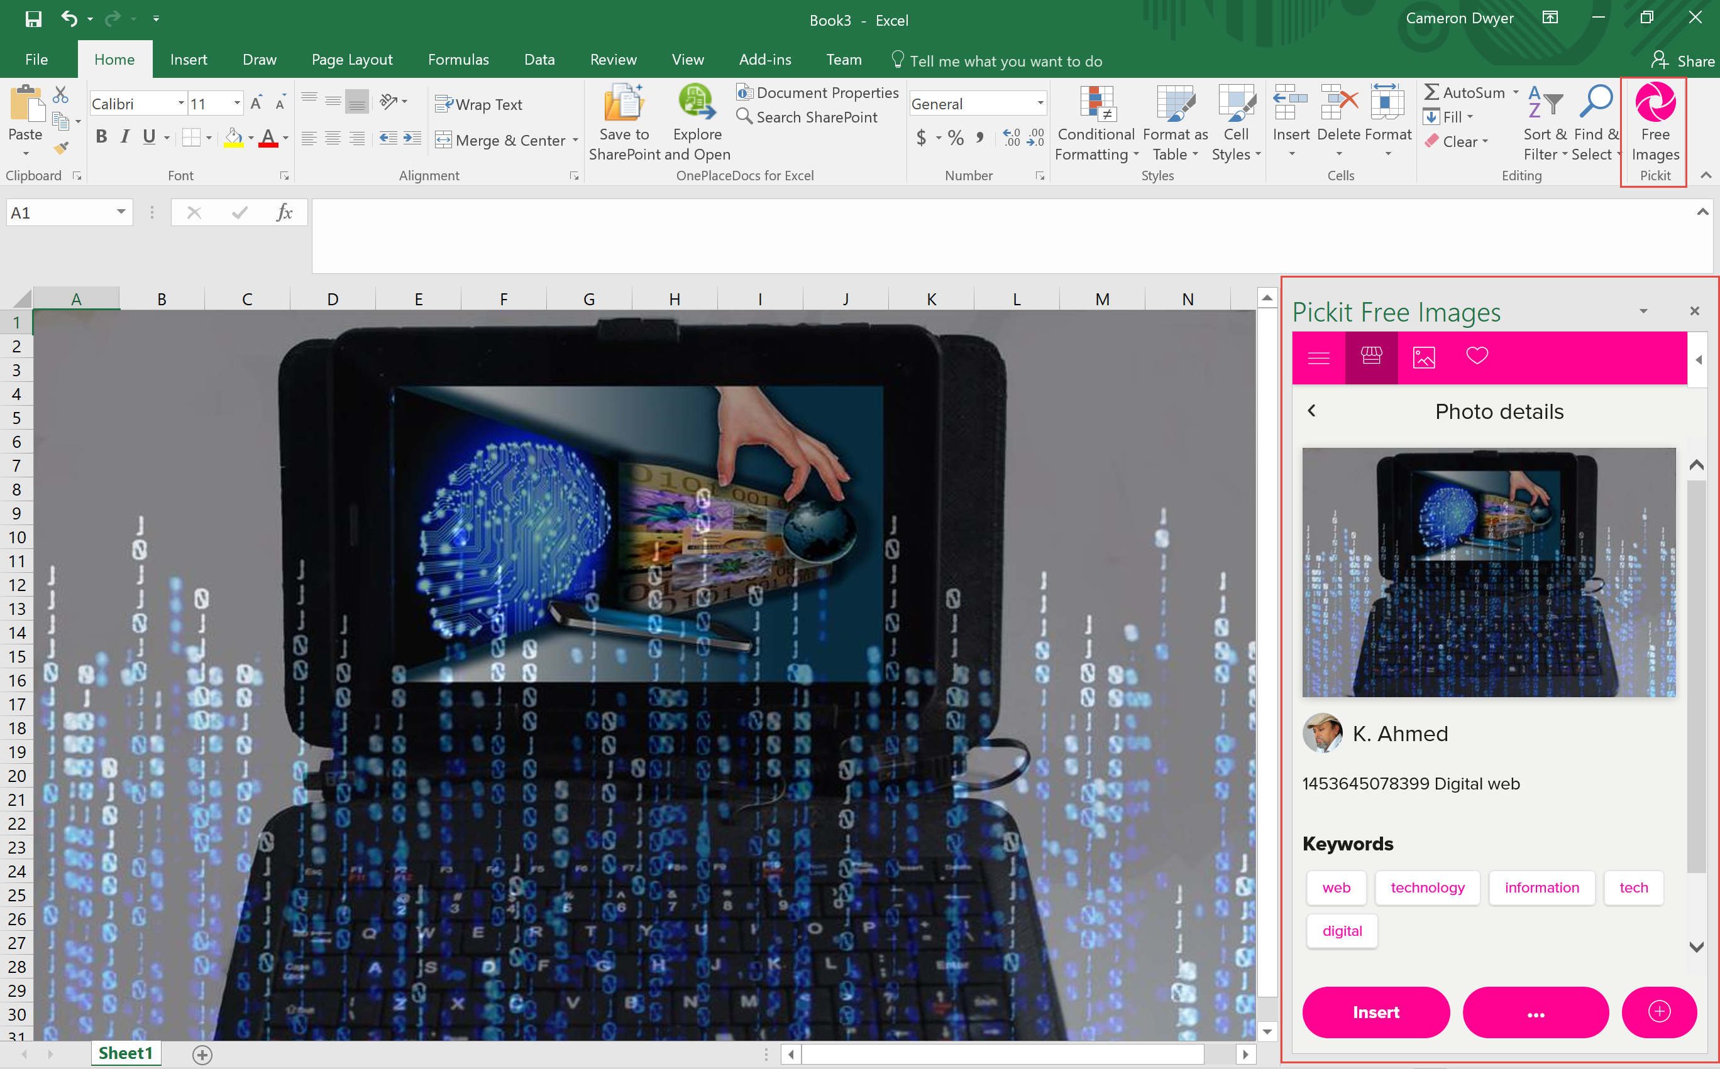
Task Pane add-ins [Demo]

Slide 10
Add-in contexts
Task pane add-in
Add-in that runs beside a document/mail with read/write access
Word, Excel, PowerPoint, Project, Outlook
Content add-in
Add-in that runs within a document content with read/write access
Excel, PowerPoint, Access
Add-in command
Command in the Office UI to launch add-in or perform UI-less operation
Outlook and Outlook Web Access (OWA)

Slide 11
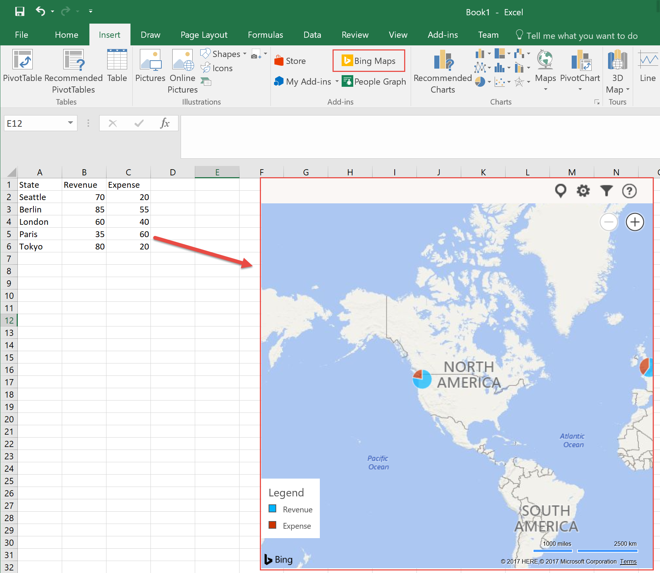
Content add-ins [Demo]

Slide 12
Add-in contexts
Task pane add-in
Add-in that runs beside a document/mail with read/write access
Word, Excel, PowerPoint, Project, Outlook
Content add-in
Add-in that runs within a document content with read/write access
Excel, PowerPoint, Access
Add-in command
Command in the Office UI to launch add-in or perform UI-less operation
Outlook and Outlook Web Access (OWA)

Slide 13
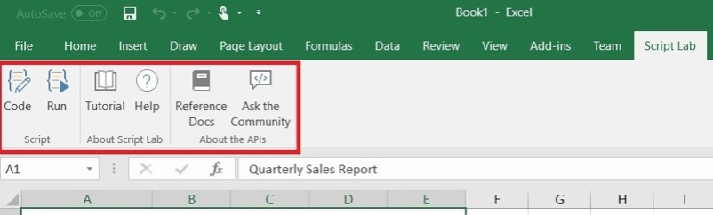
Add-in commands [Demo]

Slide 14
Office.js – the JavaScript API for Office
Office.js is the new Office API
This is a JavaScript library that you can include in the web page of your add-in
Provides access to the object models of host Office application (including current document or item)
Office.js dynamically loads in Common APIs (apply to all Office applications) and host specific APIs (such as the Word API or Excel API)
This provides strongly types object models
This allows your add-in to interact with the Office app
Microsoft iterating quickly on these APIs to remove barriers in converting VSTO add-ins

Slide 15
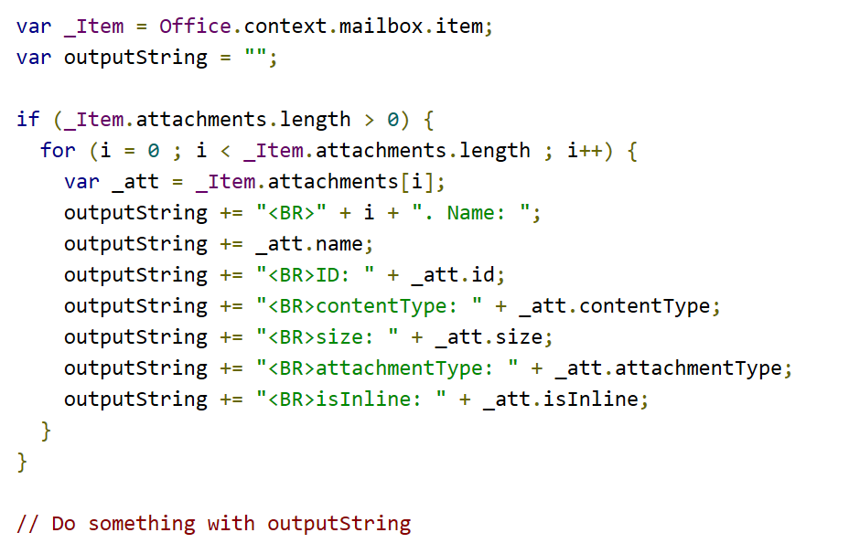
Example Office.js code

Slide 16
Deployment
Add-ins can be acquired through the Office store
Enterprise add-ins can be made available using a private add-in catalog
No code to install on user machines/devices
No elevated permissions needed
Install on one host installs on all hosts
Centralized deployment controls for organisations
Deployment is the act of associating an add-in manifest with a user

Slide 17
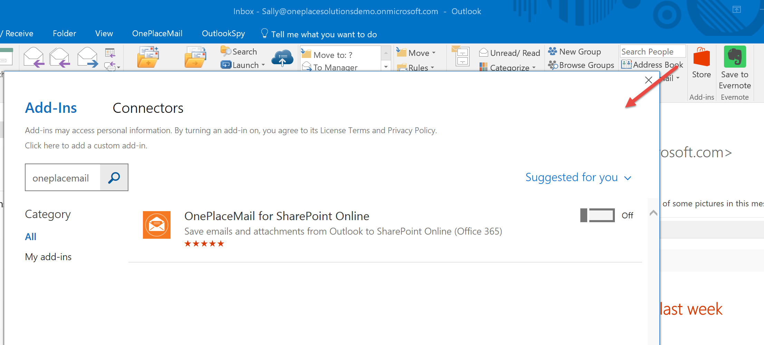
Deployment from Office Store [Demo]

Slide 18
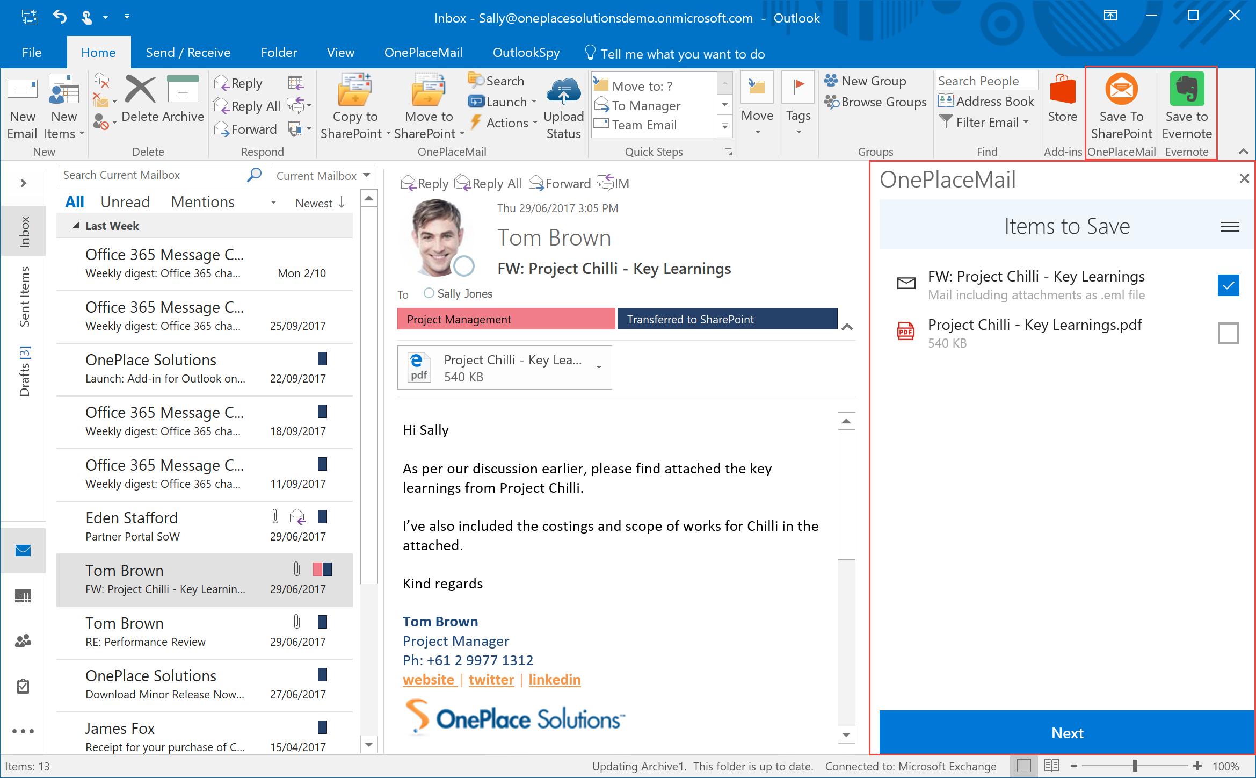
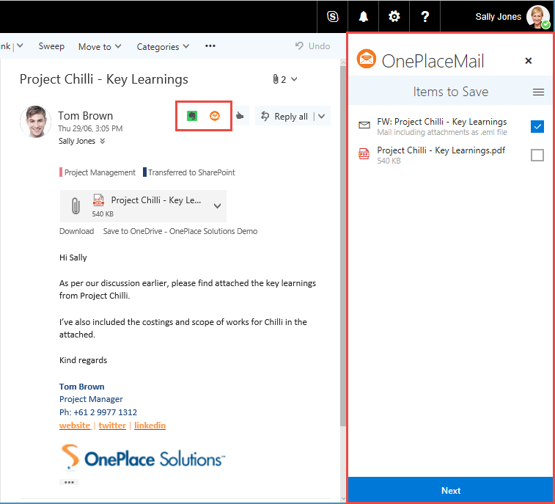
Different Hosts
Different UX

Slide 19
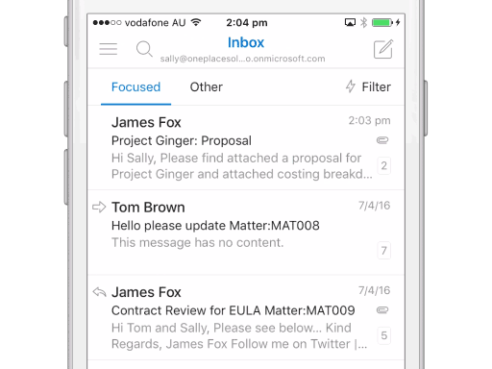
Different Hosts
Different UX

Slide 20
Modern add-in advantages over VSTO
Cross-platform support. Runs in Office for Windows, Mac, iOS, Android and Office Online.
Centralized deployment and distribution. No code installed on end user machines.
Add-ins do not affect the performance and stability of the host application.
The application is evergreen, because it's centrally hosted making a change to the web app makes it available to all users immediately. Everyone is on the same version.
Based on standard web technology. No tie in to using Microsoft stack for developing it.

Slide 21
What does this mean for Office developers?
Old model was on rails (Visual Studio, C#/VB, .Net Framework, VSTO)
New model is web standards (HTML, CSS, JavaScript)
You are essentially a web developer = power, freedom, confusion and maybe paralysis
Develop on Windows, Mac or Linux (Visual Studio code work on all of these)
HTML, CSS & JavaScript by themselves are difficult to scale when building Enterprise apps
Use JavaScript frameworks (Angular, React)
Use TypeScript instead of JavaScript (strongly typed)
But this is only part of the developer story……

Slide 22
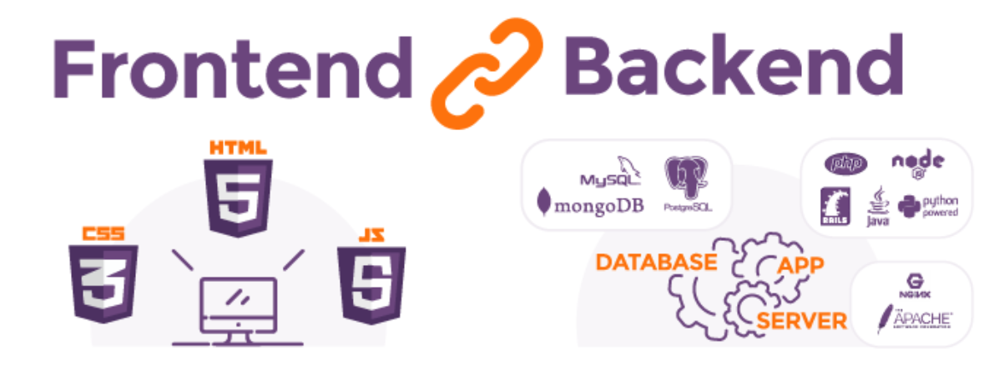
The Full Stack Developer
Most add-ins consist of a front-end AND a back-end
Front-end (Presentation layer - HTML, CSS, JavaScript) – runs on the users device in a browser
Back-end (Business logic and data layers) – runs on your server or hosted environment

Slide 23



OnePlaceMail Stack
Alternatives
Framework: Angular (SPA)
Language: TypeScript
UI: Office UI Fabric, CSS
IDE: Visual Studio Code
React, Aurelia
JavaScript
Bootstrap, Kendo UI, LESS, SAAS
Visual Studio, Sublime Text, Atom, WebStorm
Front-end
.Net Web API (C#)
Hosting: Azure Web App
IDE: Visual Studio
Node.js, Python, PHP, Azure Functions, AWS Lambda
IIS, Apache, Serverless (Azure, AWS)
Huge array of options (depends on language/tech)
Back-end
Office 365 (SharePoint)
SQL, Azure (CosmosDB, Blob, Table, Queues), MySQL, PostGres, Mongo DB
Data Storage

Slide 24
Summary
Office is now available on any device
The extensibility story has transitioned to match
This is a big shift for traditional Microsoft developers
There is much more choice for development technology and tooling
Key challenge is in understanding the different technologies and choosing wisely

Slide 25
Resources
https://dev.office.com/getting-started
https://dev.office.com/code-samples
https://developer.microsoft.com/en-us/fabric
https://angular.io/
https://reactjs.org/
https://www.oneplacesolutions.com/

Slide 26




Q & A
@CameronDwyer
camerondwyer.wordpress.com
www.linkedin.com/in/camerondwyer
www.oneplacesolutions.com

