Slide 1


Getting your feet wet with Office add-in development (without drowning)
@CameronDwyer | Microsoft MVP | CTO OnePlace Solutions

Slide 2
Agenda
What is an add-in
Why did we need a new add-in model
What is the modern add-in model
Ways can we extend and customise Office products using modern add-ins
How add-ins are deployed
My top tips for getting started with add-in development

Slide 3
What is an add-in?
Extend Microsoft 365 experiences
Documents
Pages
Conversations
Timeline

Slide 4
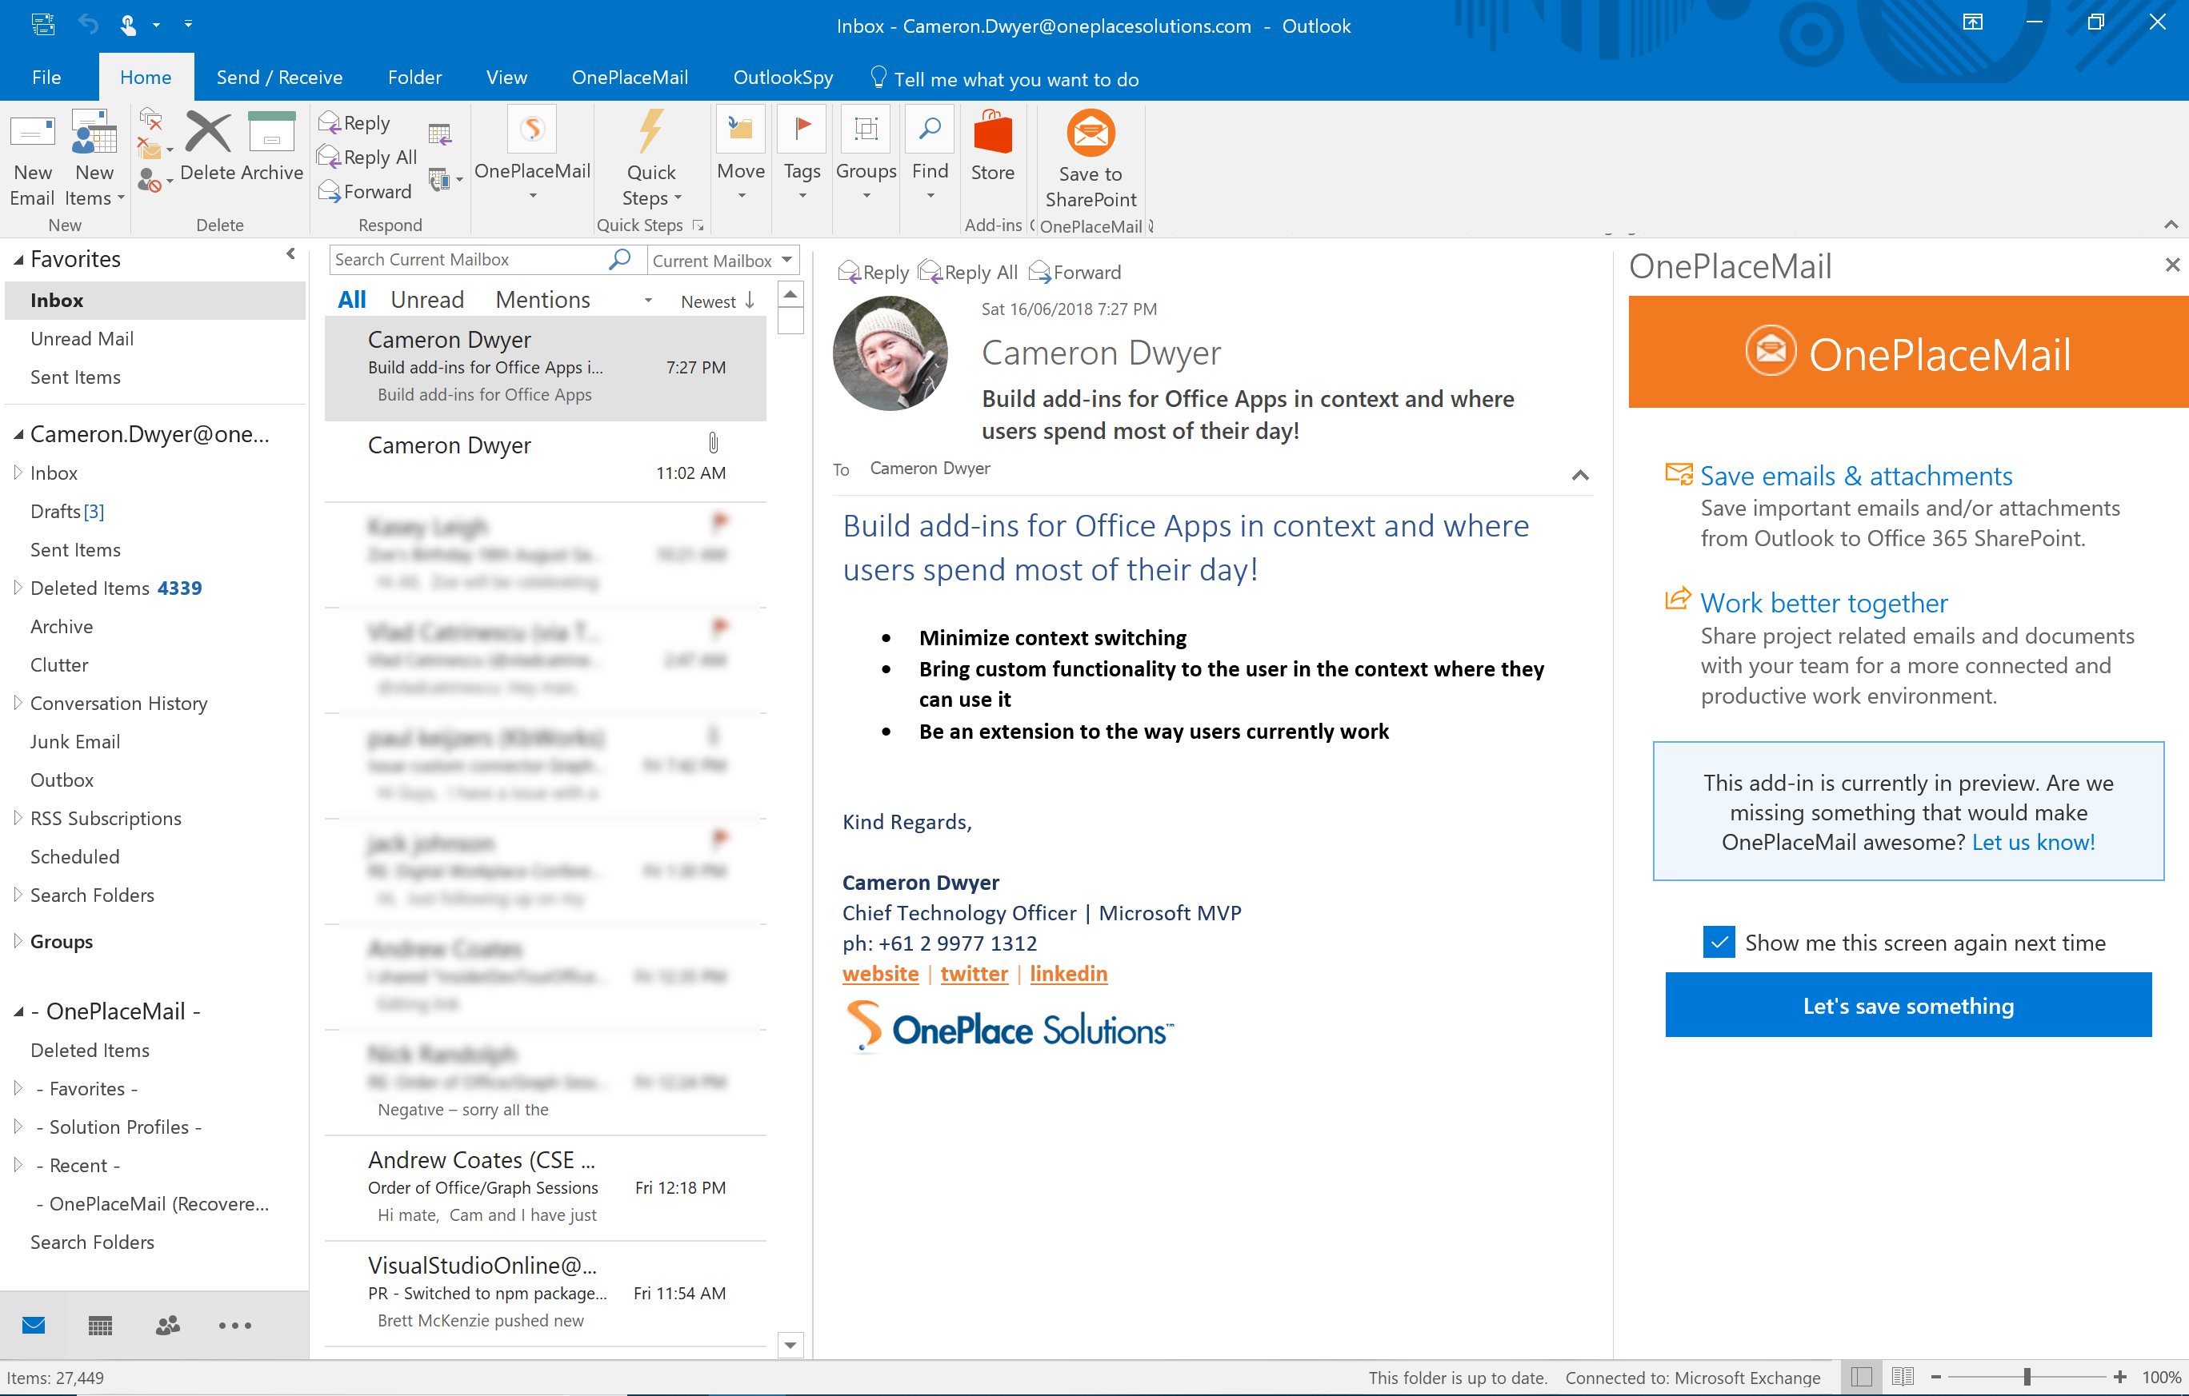
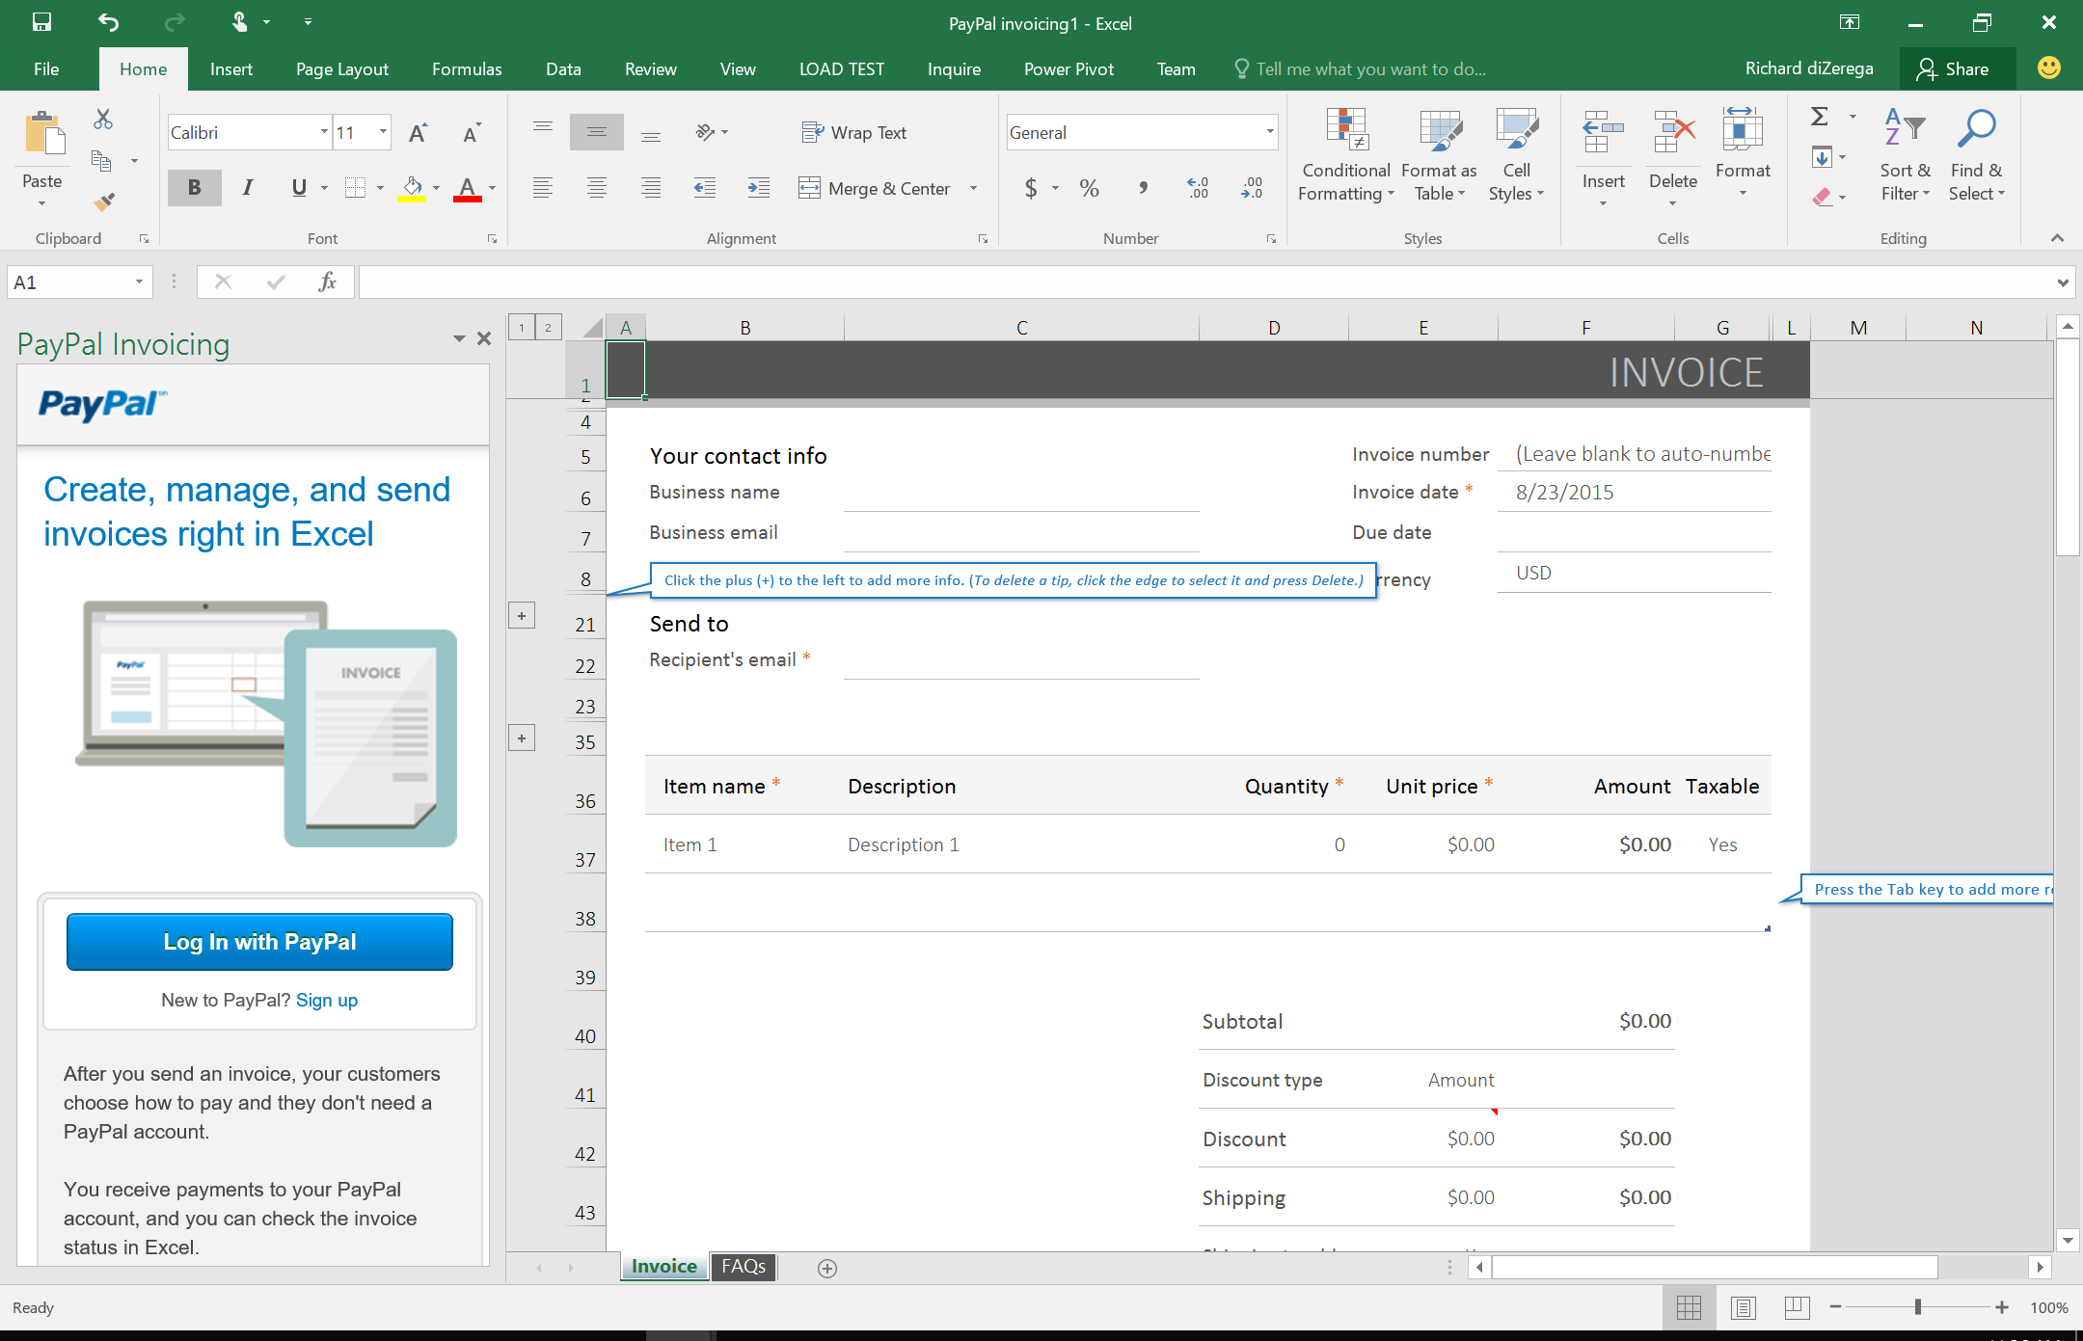
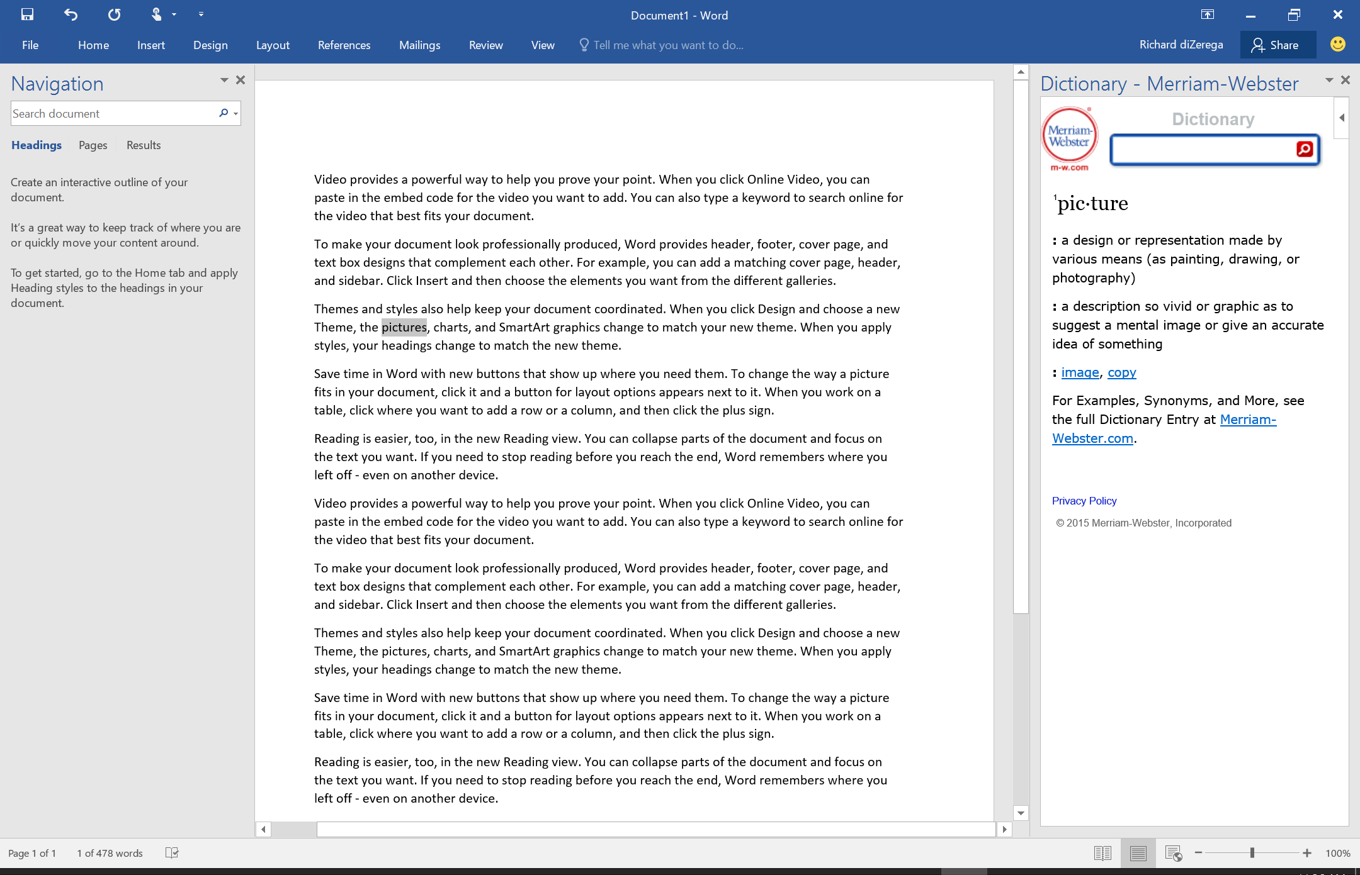
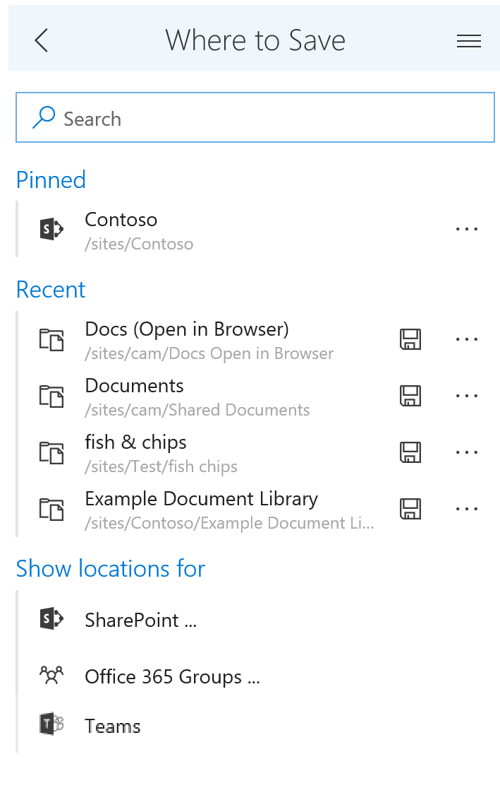
Add-ins in Office

Slide 5

Why did we need a new model?
Office is now on any device (Windows, Mac, iPhone, iPad, Android, Web Browsers)
Code isolation for performance and stability

Slide 6







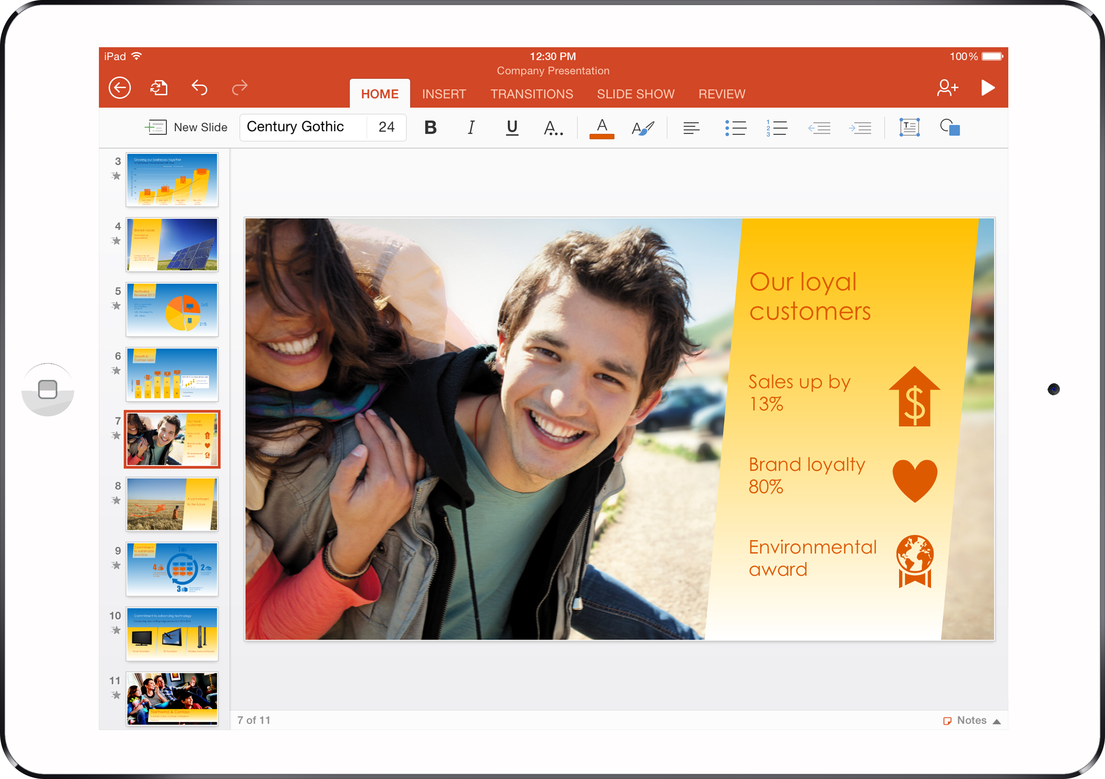

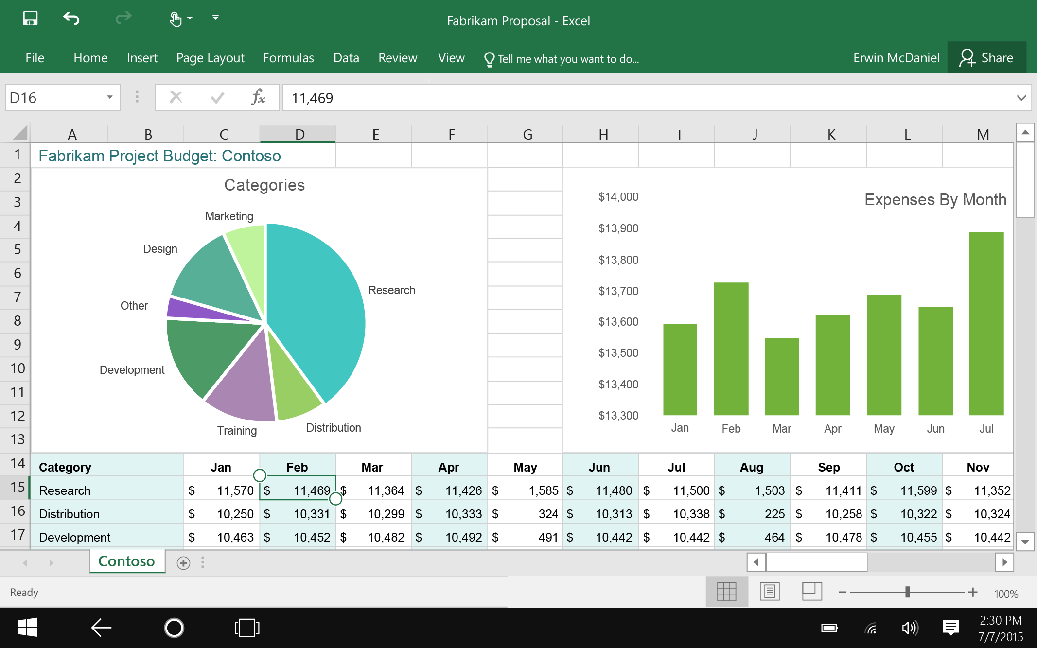
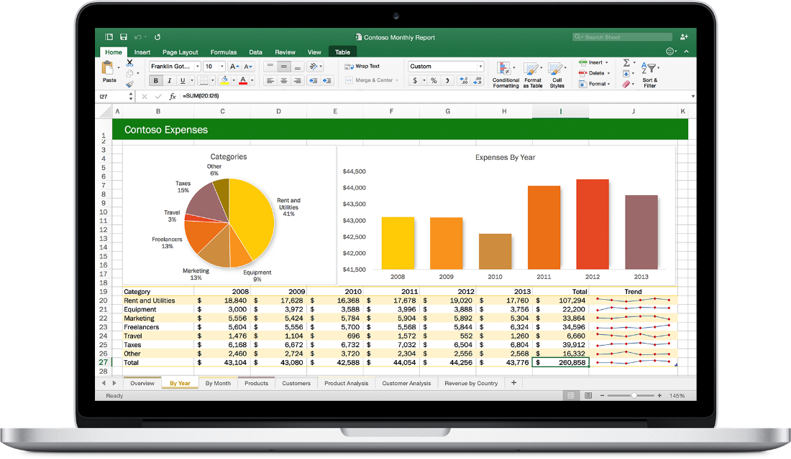

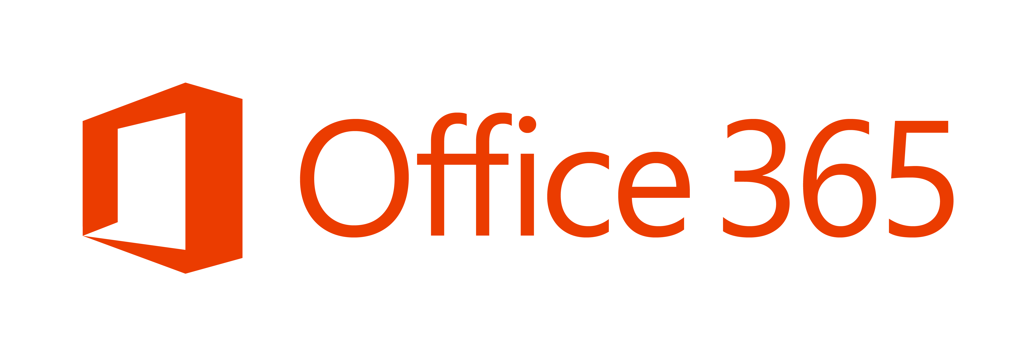
Web technologies
  Make your solution
  part of Office
Cross
platform
  Extend Office applications across platforms using web technologies
Modern distribution
Store
Centralized Deployment

Slide 7
The modern add-in model
Interact with data in a document, workbook or mail item (same as old model)
Develop once and run in Office across all platforms and devices *
The add-in is essentially a web application that can be hosted anywhere
Develop using standard web technologies (HTML, CSS, JavaScript)
Code does not get installed on end user devices
Displayed in pre-defined locations/contexts within the host Office application

Slide 8
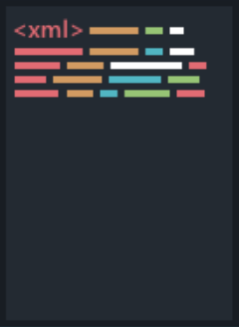


Anatomy of an add-in
XML Manifest
HTML Page
Notes:
2 critical pieces
Manifest = xml to describe the addin (title, description, where/when the add-in will show itself)
e.g. Hello World. Office App can startup and show add-in buttons without executing any add-in code
HTML Page = Manifest points to this and this is what gets loaded into the “frame” in the Office app

Slide 9



Add-in canvases
Task Pane
Add-in that runs beside a document/mail with read/write access
Word, Excel, PowerPoint, Outlook, OneNote, Project
Content
Add-in that runs within a documents content with read/write access
Excel, PowerPoint
Commands
Command in the Office UI to launch add-in or perform UI-less operation
Outlook, Word, Excel, PowerPoint, OneNote

Slide 10
Add-in Canvases & Distribution
Demo

Slide 11
Office.js – The JavaScript API for Office
Office.js is the new Office API
This is a JavaScript library that you can include in the web page of your add-in
Provides access to the object models of host Office application (including current document or item)
Office.js dynamically loads in Common APIs (apply to all Office applications) and host specific APIs (such as the Word API or Excel API)
This allows your add-in to interact with the Office app
Microsoft iterating quickly on these APIs to remove barriers in converting VSTO add-ins

Slide 12
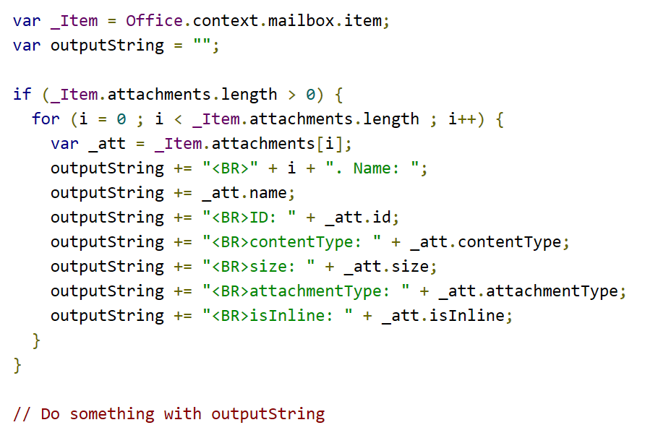
Example Office.js code
Accessing a mail item in an Outlook add-in

Slide 13
How to avoid drowning
Choice overload is a cognitive process in which people have a difficult time making a decision when faced with many options.
Analysis paralysis is the state of over-analyzing (or over-thinking) a situation so that a decision or action is never taken, in effect paralyzing the outcome.

Slide 14







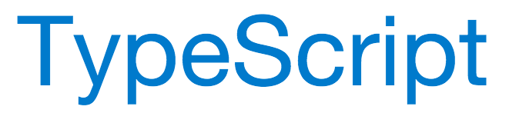

The Microsoft slide on tooling
.net
IIS Express
C#
MSBuild
Project Templates
scripting

Slide 15
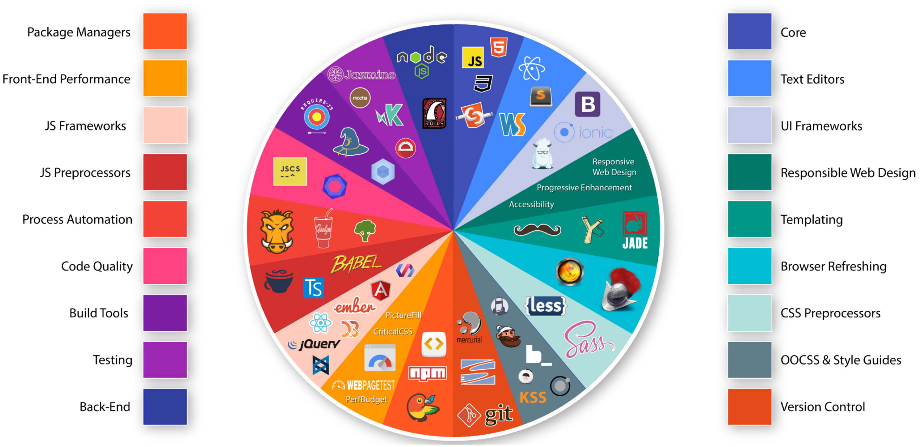
The reality of tooling
https://medium.com/@withinsight1/the-front-end-spectrum-c0f30998c9f0

Slide 16
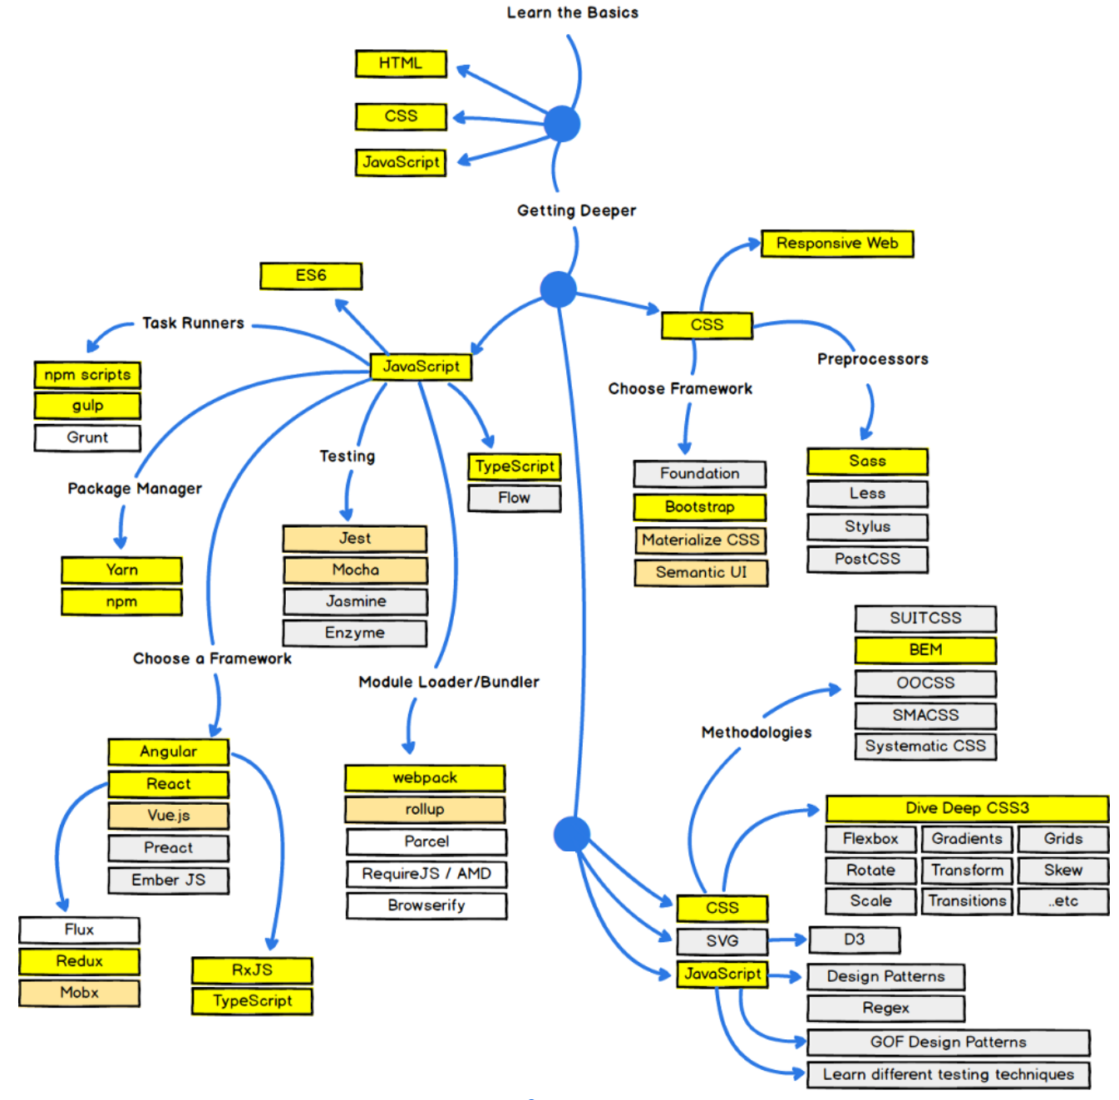

Tip#1 Use a front-end framework with a CLI
https://codeburst.io/the-2018-web-developer-roadmap-826b1b806e8d
Notes:
Away from a personal preference of tech mix to consistent set of technologies
Get pipeline up and running super fast
Versions of products that work together
Complexity of tools abstracted
Better support and help
No ongoing lock-in to the CLIs (“ejecting”)
Helps minimise analysis paralysis
Answer - Use a front end framework with a CLI. Angular CLI or create-react-app
React (Facebook), Angular (Google), Vue CLI
Lots of common tools (e.g. WebPack)

Slide 17
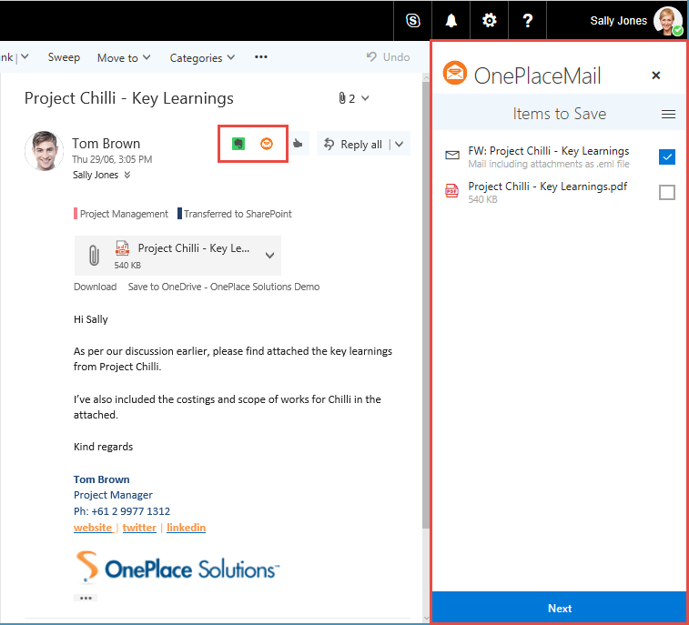
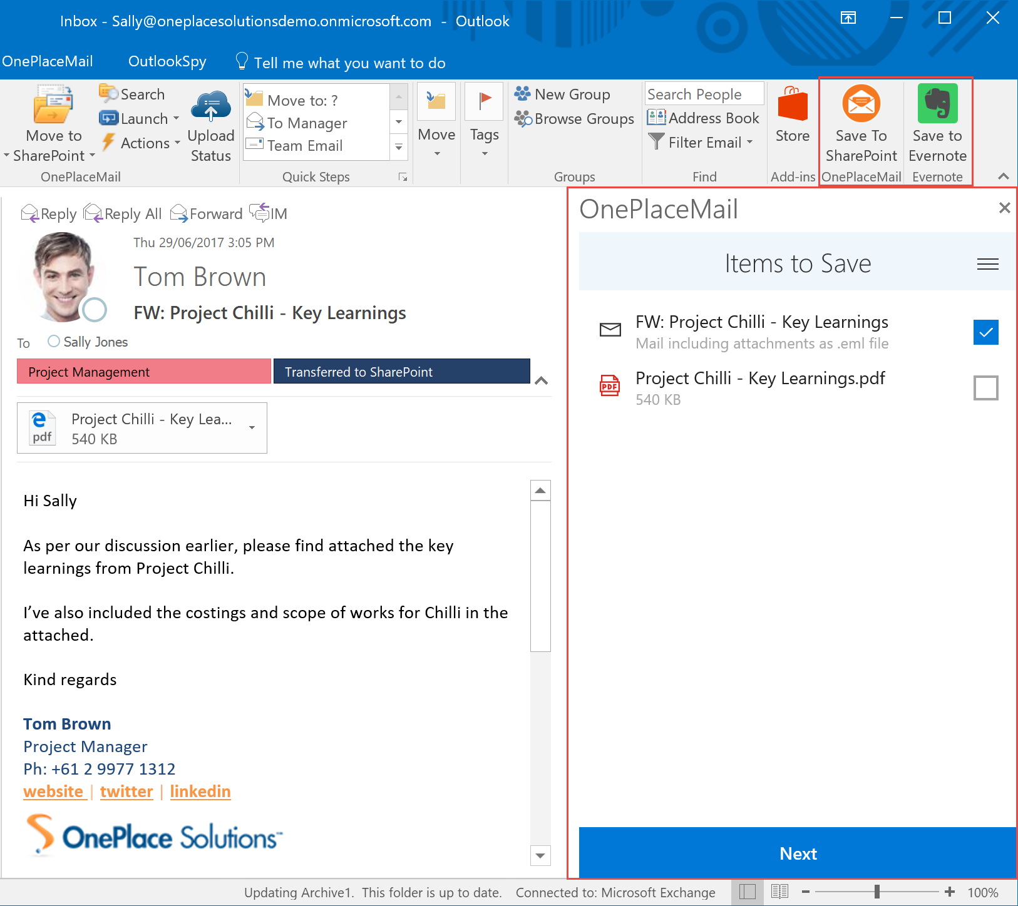
Tip#2 Different hosts = Different user experience
Plan for this early on

Slide 18
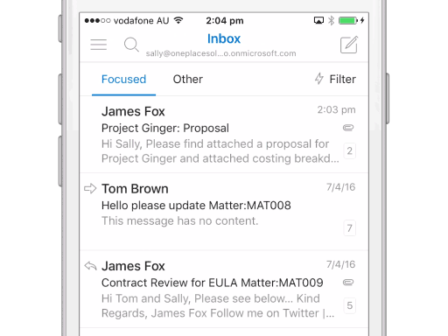
Tip#2 Different hosts = Different user experience

Slide 19

Tip#3 Use TypeScript
Don’t run in the dark with scissors
Pickup more errors at compile time rather than runtime
Better team and code scalability with interface oriented development
Better tooling - IDE can help you code in real time
Generate JavaScript that complies to standards (including future ones!)

Slide 20
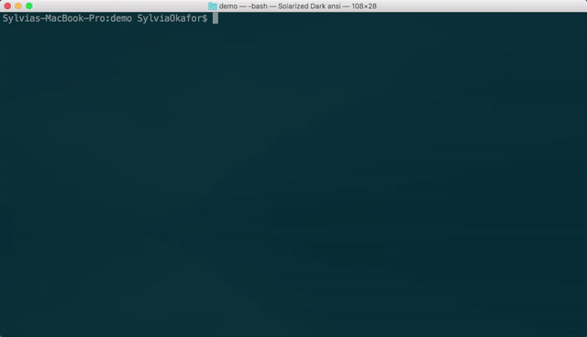
Tip#4 Use the Yeoman generator for Office

Slide 21
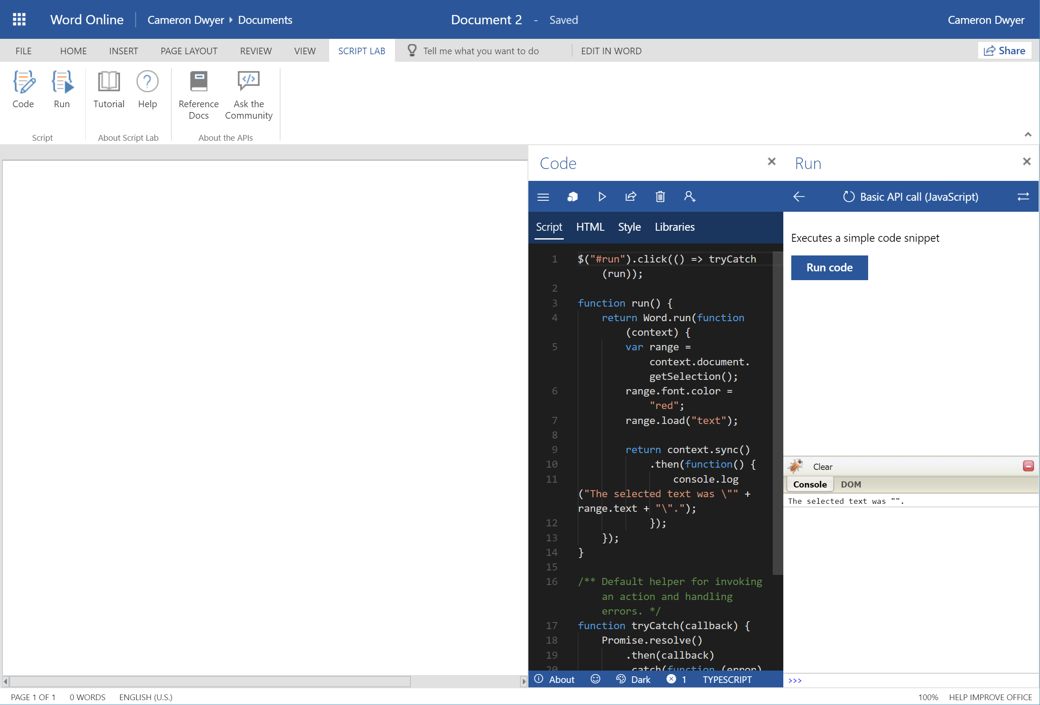
Tip#5 The Script Lab Add-in
Notes:
For exploring the Office.js functionality in real time without needing to code up your own add-in.

Slide 22
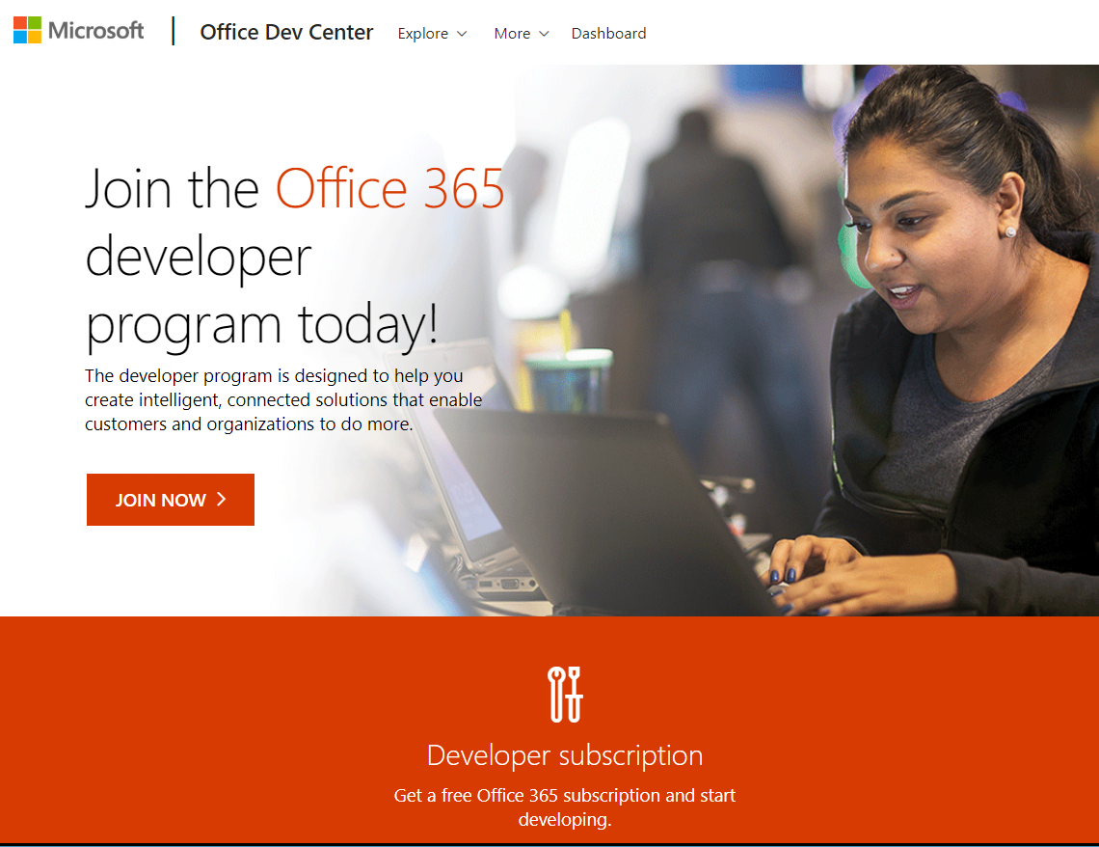
Start your journey here
https://developer.microsoft.com
Join the Office 365 developer program
Get an Office 365 developer tenant (free for 12 months)
Online training
API documentation
Over 500 code sample projects

Slide 23





















Thank you to our sponsors

Slide 24
Thanks!

