Slide 1

Microsoft Ignite
2018
SharePoint Announcements
@CameronDwyer | CTO OnePlace Solutions | Microsoft MVP

Slide 2
Agenda
Intro
Vision of modern unified UX
Intranets
Hub sites
Collaboration & teamwork
Mobile apps
OneDrive
Teams integration
SharePoint Server 2019

Slide 3

Notes:
Large focus was on end user experience improvements – we saw lots of change in the UI where technology and user connect. I think this sets the vision for a lot of the changes we saw in SharePoint with the push towards more functionality in the modern experiences.
Let’s start by watching the quick video to set the scene.

Slide 4

Intranets

Slide 5
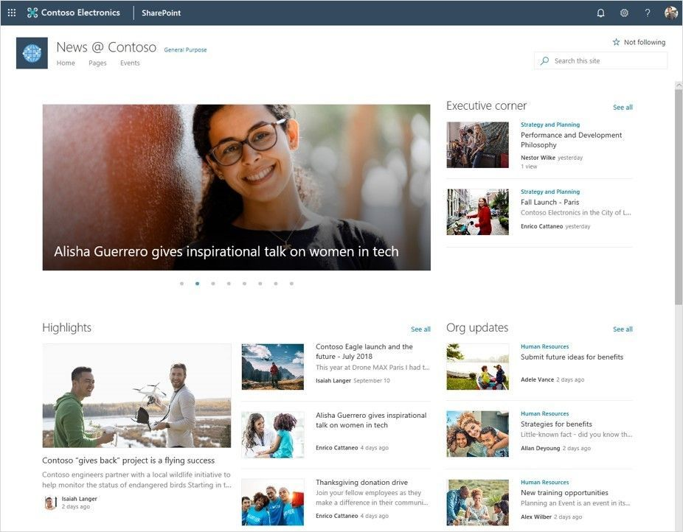
News
News Links (including external sources)
Organisational News
Audience Targeting
Notes:
News Links – Enables you to share any content including external content as News
Audience targeting – Not everything is important for every user, apply audience targeting to your news and deliver the correct information to the correct user
Organizational News – Publish important articles with the visual Tags that designate organizational news

Slide 6
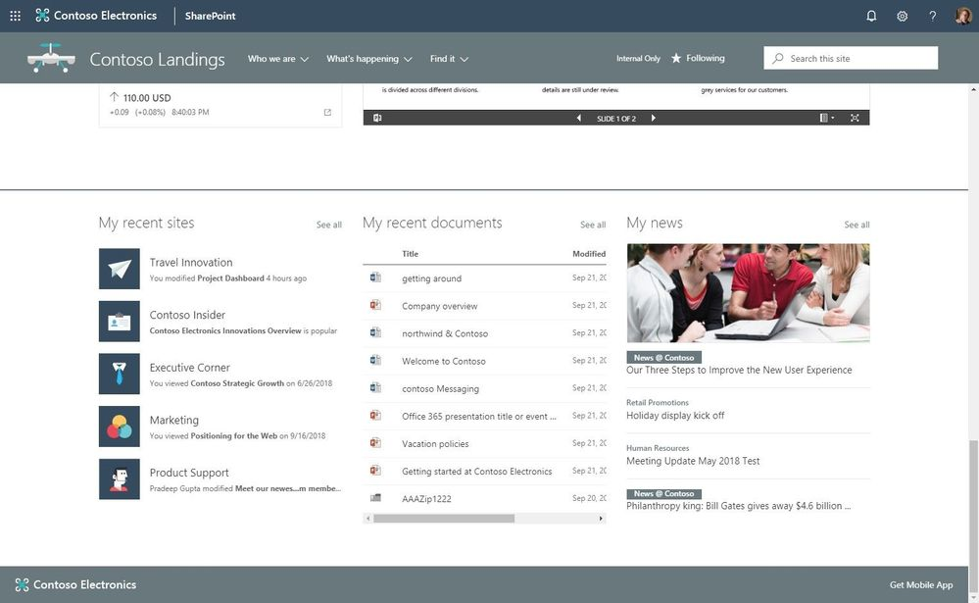
Personalised Web Parts
Personalised Recent Sites
Personalised Recent Documents
Personalised News
Notes:
New personalized webparts for the Modern UI
Personalized Views of Recent Documents (also available via Graph API)
Personalized Views of Recent Sites (also available via Graph API)
Personalized News

Slide 7
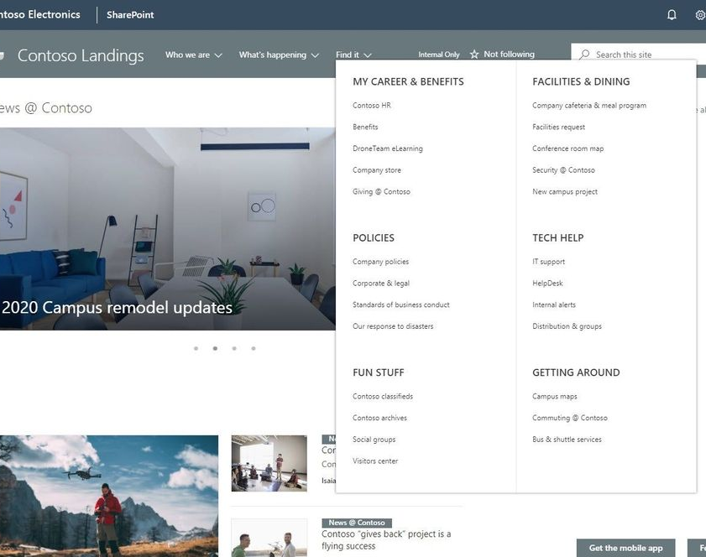
Megamenu
For site and hub navigation
Multiple levels of hierarchy at once
Modern structure is flat – use hubs and megamenu structure to provide a “virtual”
Notes:
Modern structure is flat – use hubs and megamenu structure to provide a “virtual” hierarchy
Hierarchy is then agile and you can move sites around in hierarchy by change naviagtion
New megamenu layout for site and hub navigation - Increase the value and space of your site navigation. The new megamenu options allow for multiple levels of hierarchy at once - no fly-outs needed. This will enable you to better organize and showcase the related content and sites associated under that hub site.

Slide 8
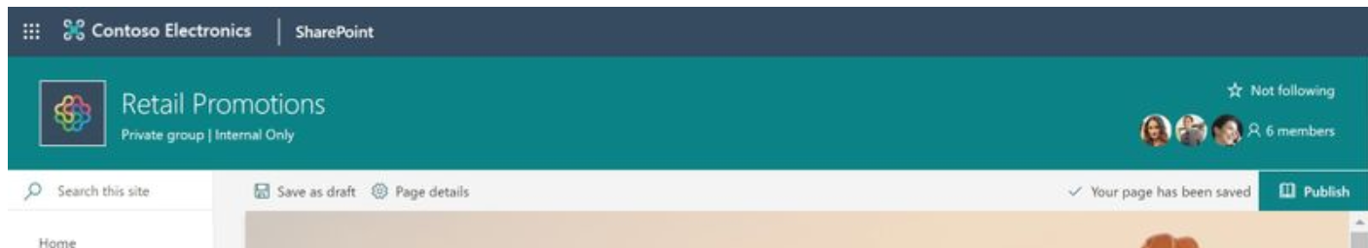
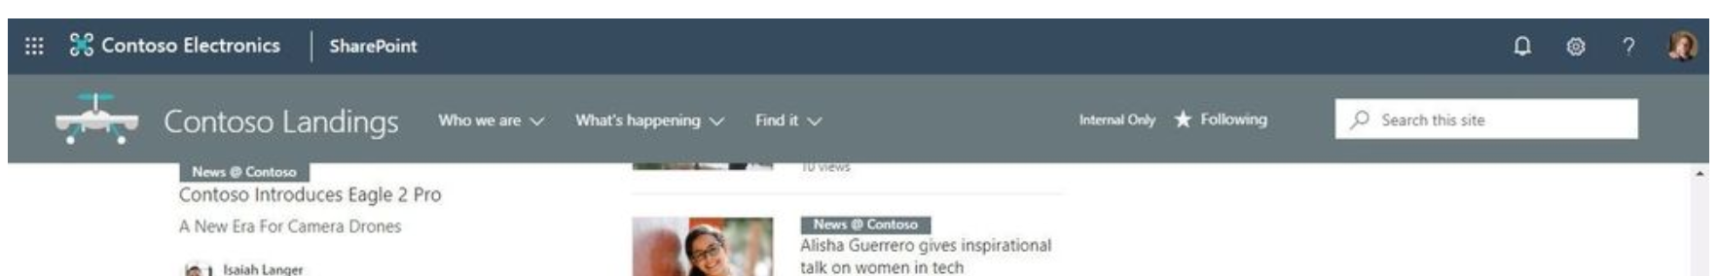
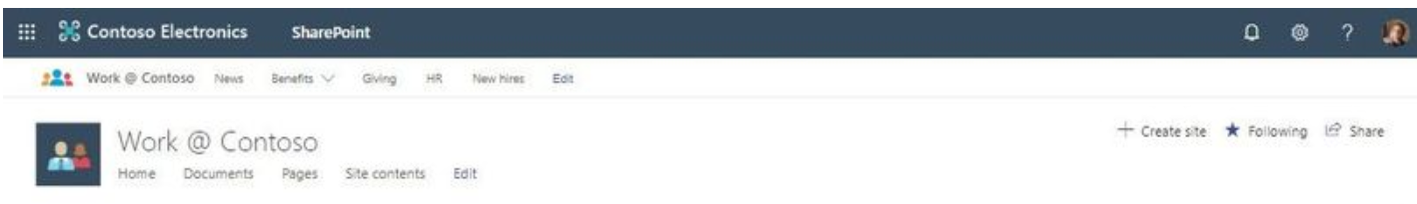
Site Header Layouts
Standard
Minimal
Compact
Site Footer
Add site footer that will show at bottom of each page
No need to develop it anymore!
Notes:
Sites: header layouts - Now, site owners can reclaim some of the vertical space at the top of the site and highlight the main page content instead. There will be three new choices: standard, minimal and compact.
New page title region options – As you begin to create the look and feel of your page, you now have more control over what the title region of your page looks like. You can choose from several layout options, alignment of where the overlay text resides, add text labels, show published date and author and provide alternative text to enhance the accessibility of your page.

Slide 9
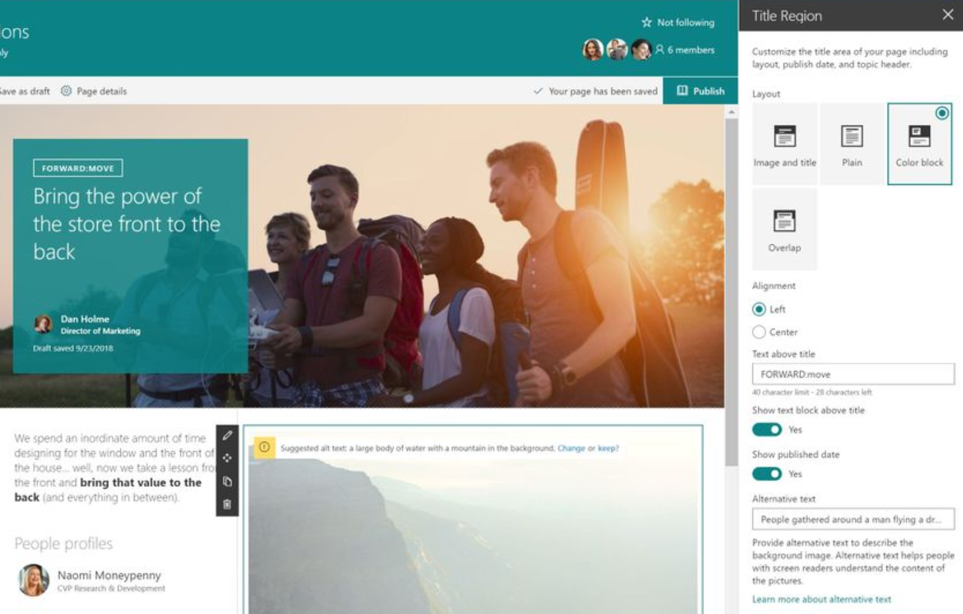
Page Title Region
Several layout option
Alignment of text overlay
Text labels
Published date
Notes:
*Click to pulse
New page title region options – As you begin to create the look and feel of your page, you now have more control over what the title region of your page looks like. You can choose from several layout options, alignment of where the overlay text resides, add text labels, show published date and author and provide alternative text to enhance the accessibility of your page.

Slide 10
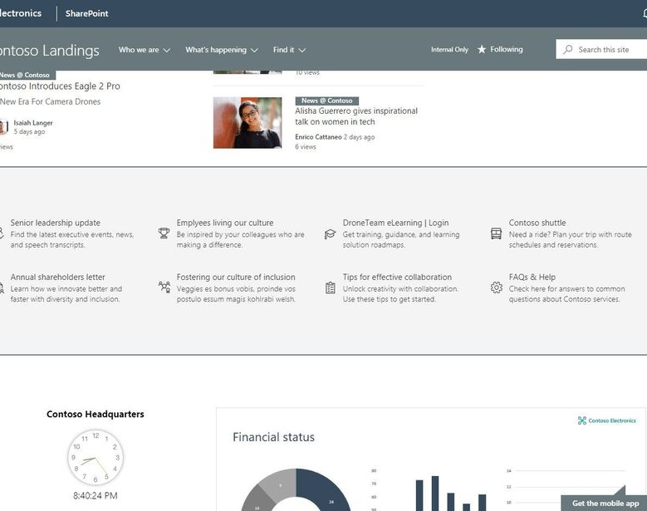
Page Section Background Shading
Set different colours for the page section backgrounds (or leave them white)
Notes:
Page section background shading - Create additional visual design and clarity as a user scrolls through your content. Now you can add different colors to the background of your page sections or leave them white as they are by default.
Make your pages and news easier to consume by using distinct shading of individual sections.

Slide 11
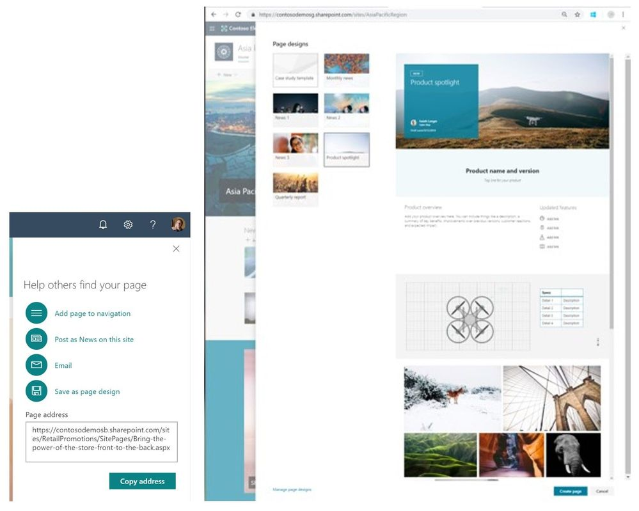
Page Designs
Save an existing page as a page design
Users can create new pages based on a saved page design
Notes:
Page designs to reuse and standardize content - Save your creators time when they generate new SharePoint pages, and ensure that the consistency of experience for how you promote your content and information remains intact. You can control the design and layout of your pages by simply designing one that can then be used by many.
After laying out your page in a preferred design, you can click Promote and save it as a page design to speed up future page creation times that benefit from the same design and layout.
You, too, can now duplicate entire sections or individual webparts to speed up your page creation experience.

Slide 12
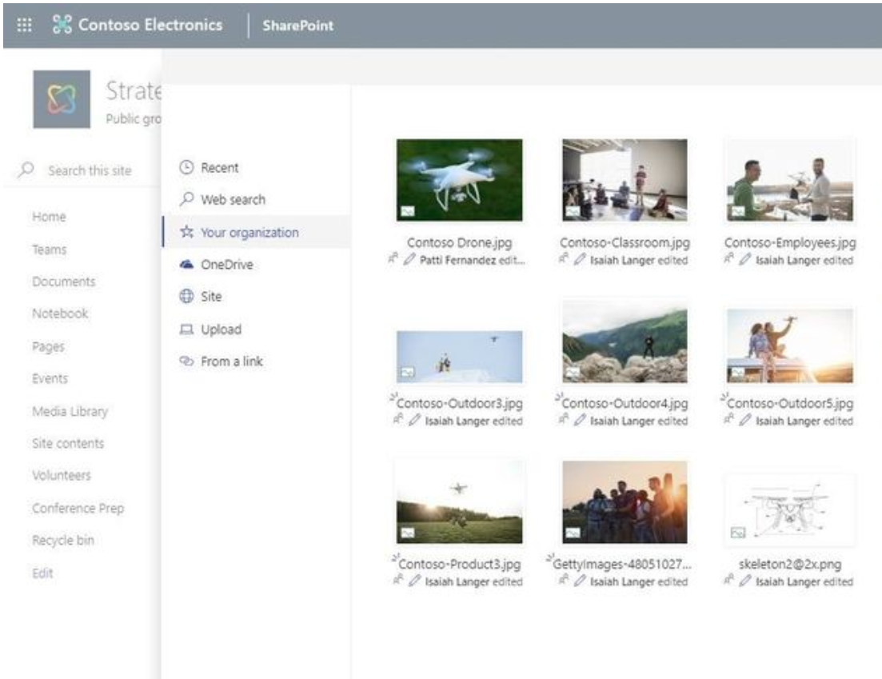
Central Asset Library
Company approved images that everyone can leverage
Use in title regions and image webpart
Notes:
Central asset library – provide easy access to your organization’s approved images that can be leveraged by everyone. When a person needs an approved image, or one that was purchased for licensed use throughout the intranet, they can click on “Your organization” and navigate files and folders of assets that are centrally managed for use in title regions and the Image webpart.

Slide 13
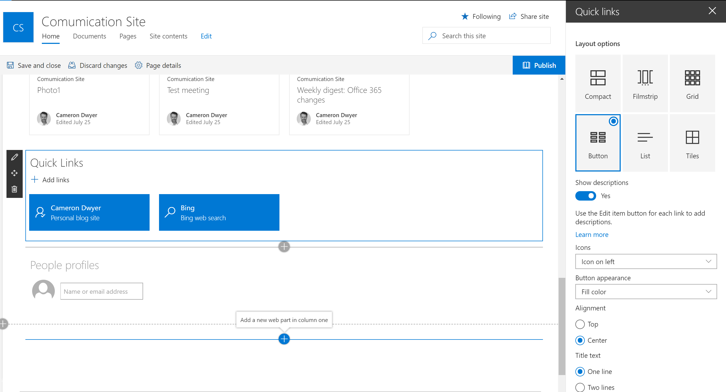
Quick Links Layout
6 layout options
Custom images or Office UI Fabric icons
Multi-line titles
Descriptions
Much more
Notes:
The Quick Links web part is getting some awesome new layouts. You can now add an icon to links and display links as a simple list, a button, a grid, and a tile in addition to the current compact and filmstrip layouts.

Slide 14
Other Intranet Announcements
Countdown timer webpart
Enable communications site at root of the tenant
Notes:
Web part: countdown timer – Site owners and members will now be able to show a countdown timer to important launch dates, key meetings, campaign ends, etc. on their site home page, within subpages and/or within a news article on team sites, communication sites and hub sites. Simply add the web part to your page or news and tap in the target date and time to count down to. And voila, everyone can see how much time until that important date and time.
Enable communication site experience at the root of a tenant – we know one of the most important sites of a your Office 365 investment is the root site, the default one that is created and has the shortest URL: https://[yourTenant].sharepoint.com. And now it’s time for this to be a real place to communicate. The default for new tenants will be that a communication site gets provisioned at the root site. Start the root off right, and the rest of your intranet will grow and flourish off of it. Note: existing tenants will also have options to enable the communication site experience at the root of their tenants. In 2018, we are rolling it out with a limited scope and will gradually cover more root site scenarios for existing tenants.

Slide 15
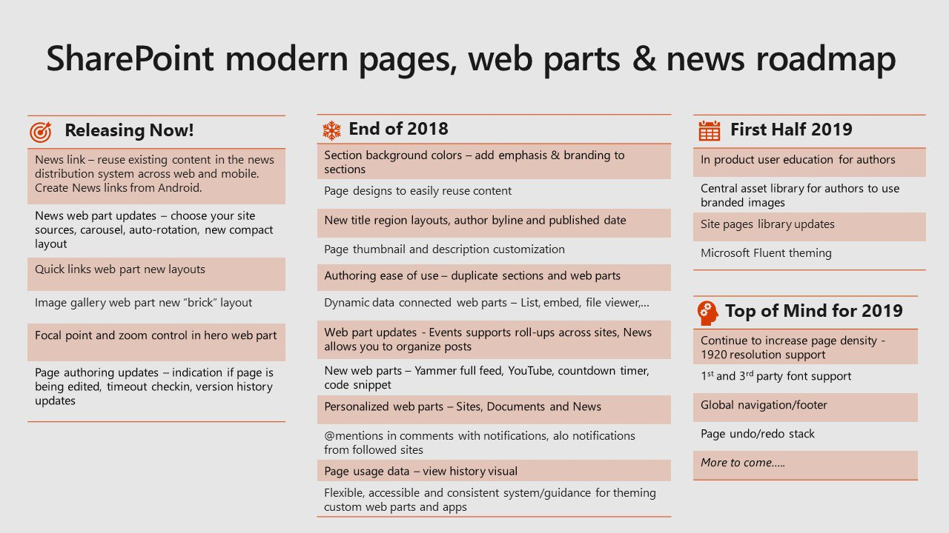

Slide 16
Hub Sites

Slide 17
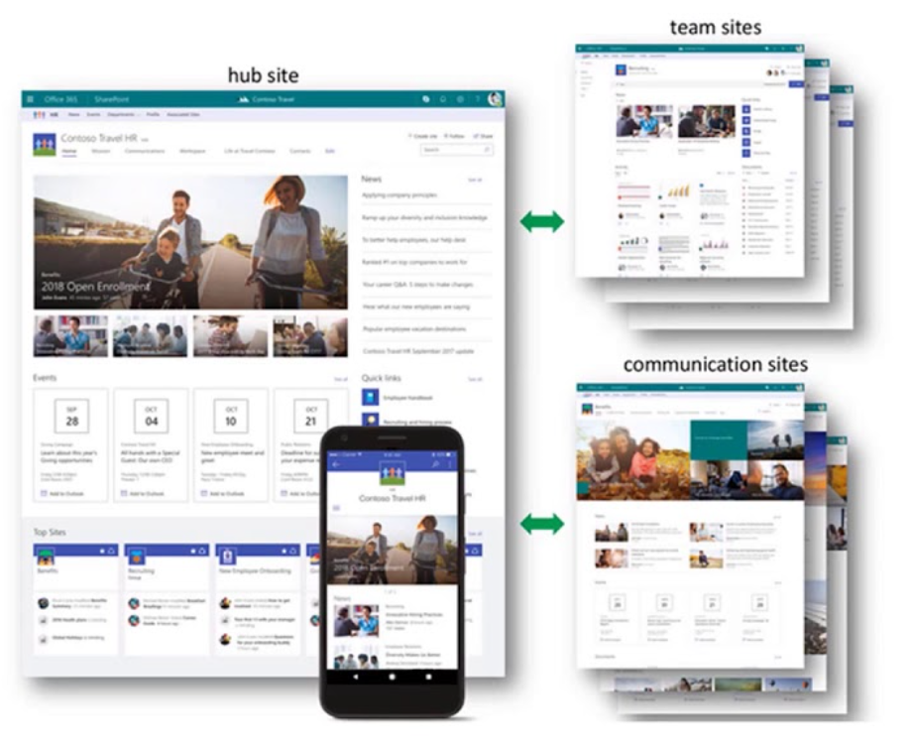
New Hub Features
Create associated site from hub
Approval process when associating site to hub
Limit increase to 100 hub sites per tenant
Notes:
Create associated site from within hub site itself - Make governing sites associated to a hub site easier by having them automatically associated and created from within the hub site itself. You'll connect sites to hubs by using a new button right on the hub site itself -- when you tap it, you get our normal new site experience and the site will be automatically associated to the hub site.
Approval on association - A flexible approval process further empowers hub site owners and site owners to make requests and programmatically adapt to changes within their growing, dynamic intranet.

Slide 18
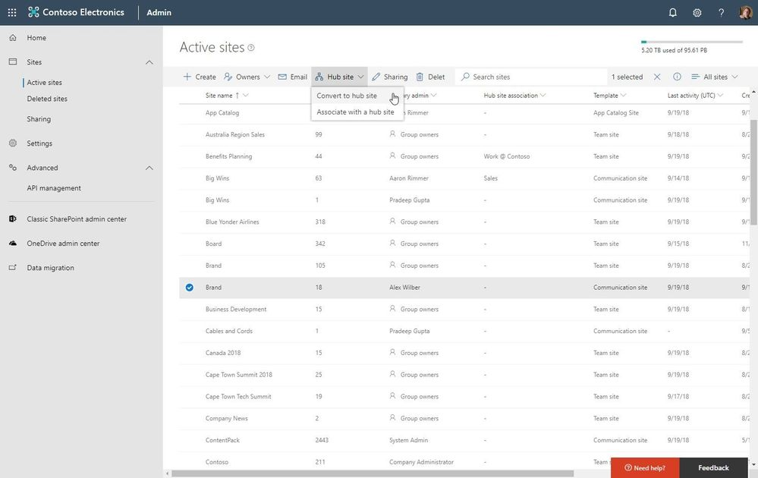
Manage in Admin Center
Create
Associate/disassociate
Report
Notes:
Create, associate/disassociate, plus report on hub sites in the SharePoint admin center in Office 365 - The SharePoint admin center in Office 365 will now allow you to create SharePoint hub sites and associated other sites once the hub site exists. This also provides a view into hub sites as they exist allowing for common admin tasks like reporting, contacting and managing sites - now including hub sites from the admin center user interface. The hub site association column also lets you see the sites associated with a hub.

Slide 19
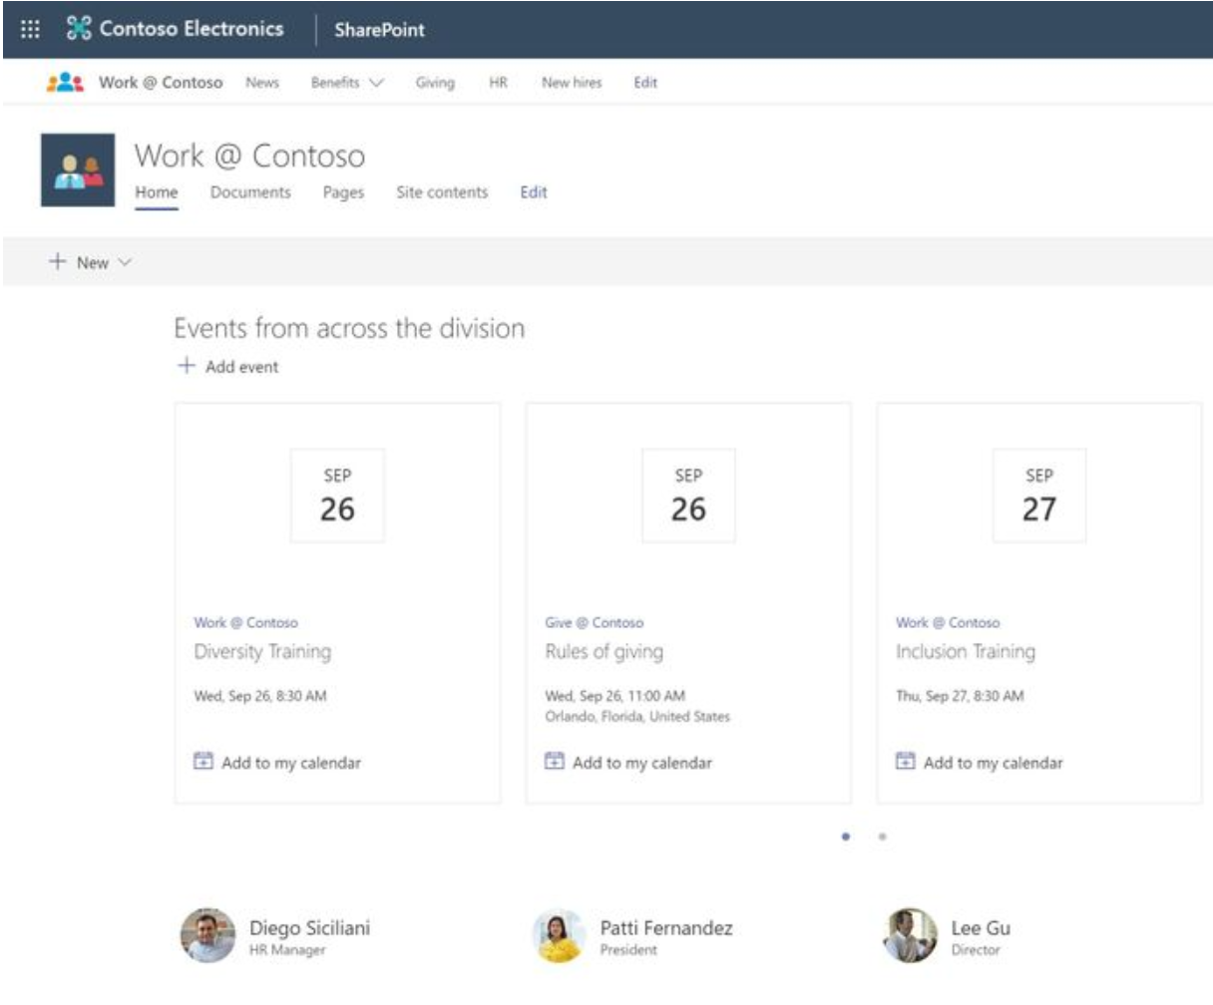
Events Web Part rollup
Roll events up from associated sites
News already has this functionality
Notes:
Events web part rolls up events from associated sites - Like the News web part and Site activity, commonly used on the home page of a hub site, you can now leverage the Events web part to roll events up from associated sites so that the aggregated view of all events appears at the hub site level.

Slide 20
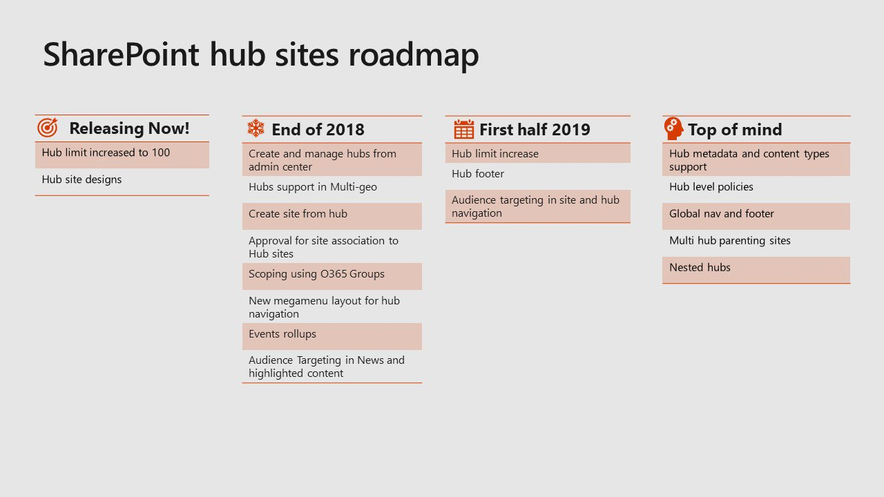

Slide 21
Collaboration &
Teamwork

Slide 22
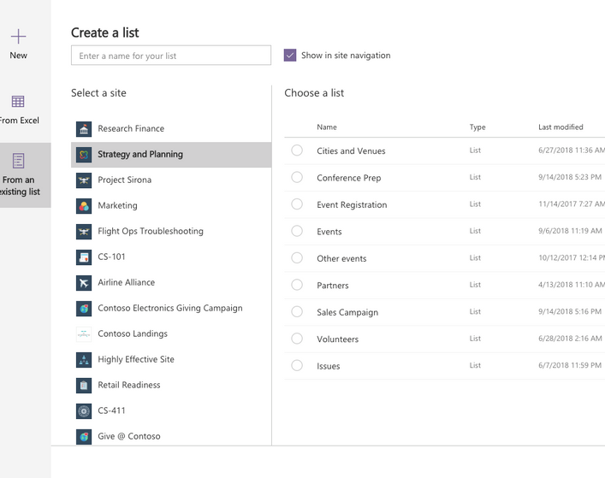
Easy list creation
From Excel
From an existing list (no need to create a template)
Coming Q4 2018
Notes:
You can build new lists directly from the structure of existing lists or from Excel tables. Copying list structures also brings over custom views and formats. [Coming Q4 2018]

Slide 23
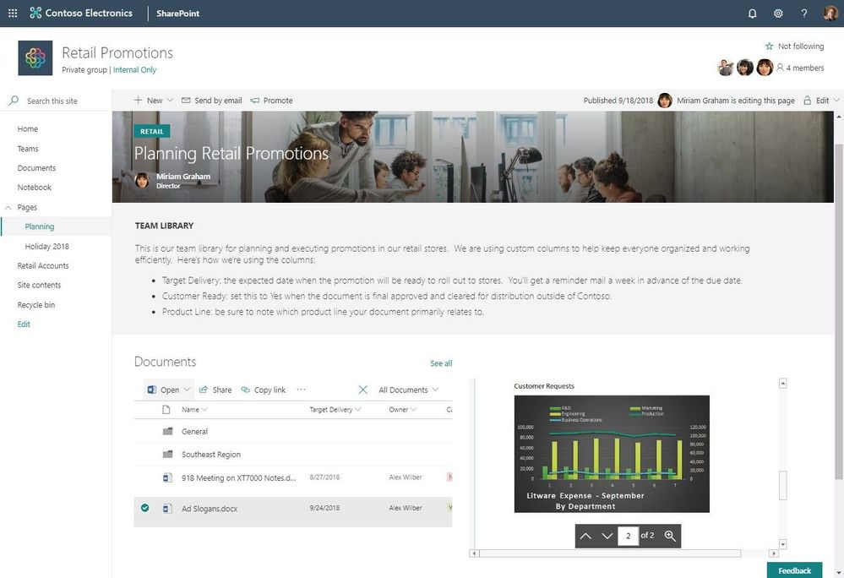
Dynamic webpart connections
Lets web parts talk together
Providers/consumers model
Initially supported for:
  List (provider)
  List properties (consumer)
  File viewer (consumer)
  Embed (consumer)
Notes:
Webpart-to-webpart connections – Let web parts talk to other web parts and your pages and experiences become more dynamic with data and interactive. You will be able to configure web parts to get their property values from other web parts, including updating those values based on what is selected.
Initially we will support dynamic data in a few of our 1st-party webparts, with the intent to grow these capabilities through the SharePoint Framework - more and more web parts (talking to other web parts).
List (data provider)
List properties (consumer)
File viewer (consumer)
Embed (consumer)

Slide 24
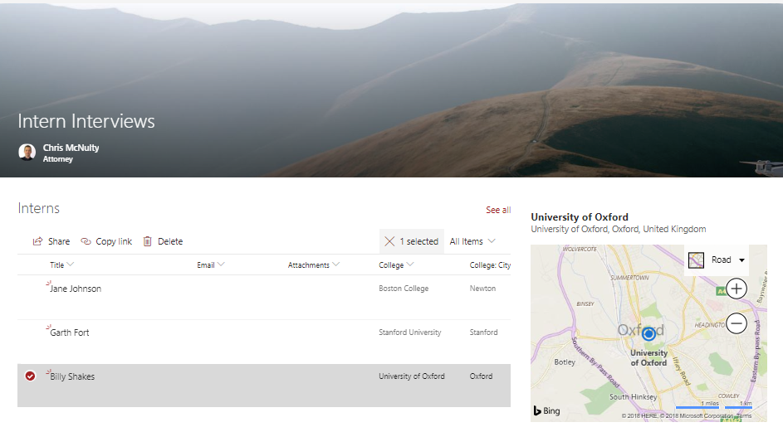
Location Column
Single field entry
Based on Bing mapping data
Filter and sort on any aspect like city or state
Notes:
Locations can greatly enrich any business data – but coordinating multiple fields for coordinates, address, and location names can be hard. Our new location column allows you to browse Bing-based mapping data to tag items and documents with location data. You can even filter and sort on any aspect of the location, like city or state.

Slide 25
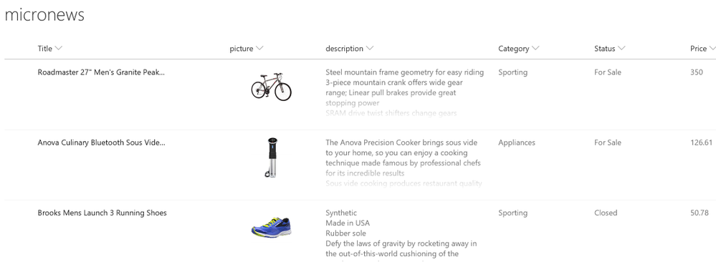
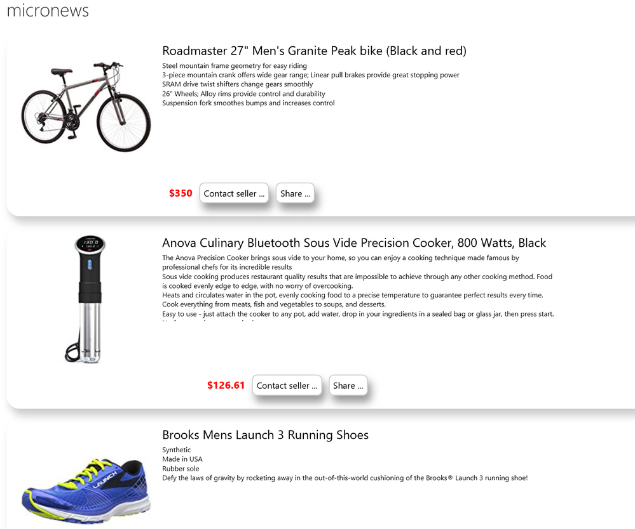
View formatting
This was announced last year
Column formatting via JSON
Row/View formatting via JSON
Cut/paste JSON into SharePoint UI

Slide 26
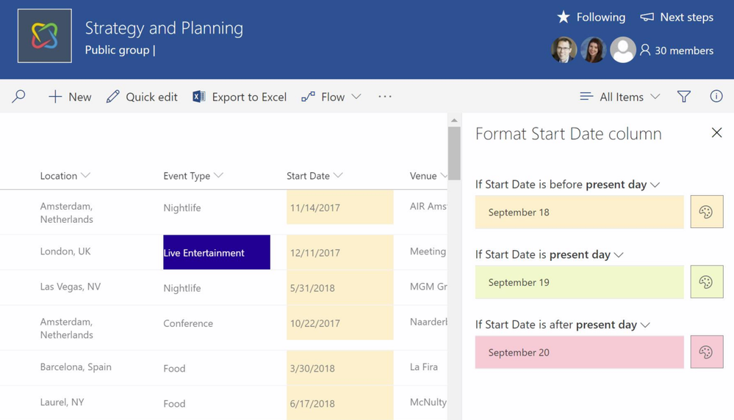
Conditional Column Formatting (no code)
Column formatting without JSON (new!)
Notes:
Last year we introduced column formatting, which lets you use cut-and-paste JSON scripts to bring visualization, formatting and interactivity to SharePoint columns.
Coming soon, you’ll also be able to conditional formatting without using any JSON scripts.

Slide 27
Other announcements
Predictive view indexes up to 30 million items
Change column width for views (and have them persist)
Freeze column headers
Column totals (although performance issues here)

Slide 28
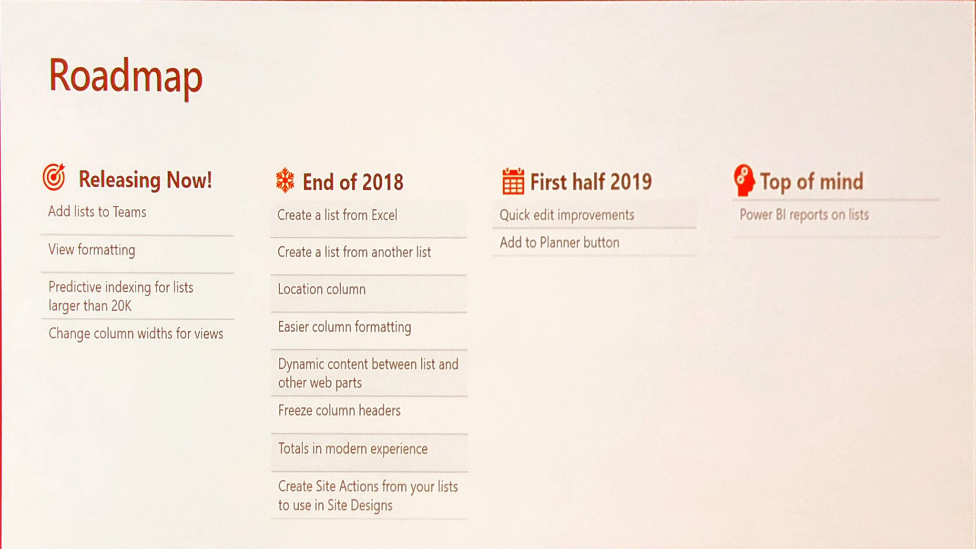

Slide 29
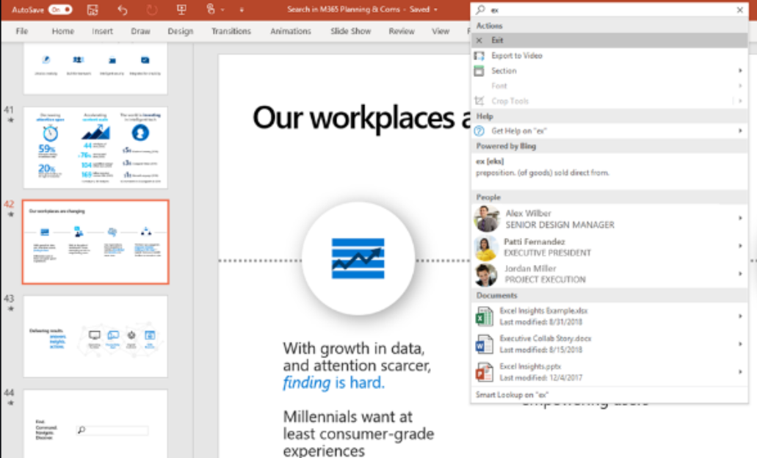
Microsoft Search
Ignite search experience video
Vision of one prominent & consistent search experience across all organisational data
Not just in Office but also Bing and Windows
Conversations included (Teams + Yammer)
Contextual actions for the host product
Audio and video keyword search (AI transcription services)
Photos become searchable (AI classification and text extraction)
Notes:
Intelligent search across audio, video and photos
recognize objects, and extract text in photos. This recognition and text extraction allows you to search for images as easily as you search for documents. For example, you could search a folder of scanned receipts for the receipt that mentions “sushi.” Video and audio files also become fully searchable thanks to the transcription services described earlier.

Slide 30
Mobile Apps

Slide 31
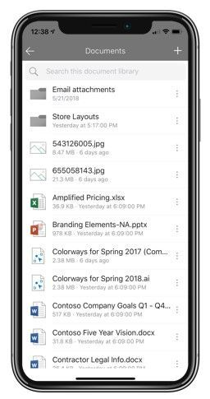
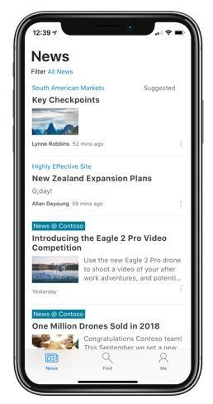
SharePoint Mobile App
Stay in SharePoint app when viewing library content (still get switched to OneDrive for richer actions)
Organisation news support
Support for creating News links from external sources directly from the app
@mention supported for commenting on news
Notes:
Document library access – As you tap into a SharePoint document library, you will stay within the SharePoint mobile app experience (for viewing and navigating) before taken through to the integrated OneDrive app - where you can perform richer actions on files. This same SharePoint document library viewing and navigating is coming to the Outlook Mobile app, too.
Organizational news support – As you tap into the SharePoint mobile app News tab, you'll now see support for organizational news - which brings greater control, process and reach to how news can be published and consumed throughout your organization.
Create news links - With News links, you can now bring in news articles from external sources. And now you can do this from your mobile device’s share option - through to the SharePoint mobile app. Once you share it, the news article goes into the SharePoint news service as a new News article. And when a person clicks on it, they will be taken to the original source to read the article. Note: this feature will initially only be on the SharePoint mobile app for Android.
@mentions within comments - When viewing a news article within the SharePoint mobile app, you can now directly @mention a person from within your organization and they will be notified - aka, drawn into the article and your response to further engage on what's happening around you. Bring people into the discussion - @mention them.

Slide 32
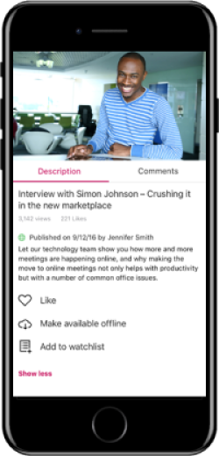
Stream Mobile App
Discover and engage with video across organisation
Offline viewing
Notes:
Today, video is becoming the preferred medium to create compelling news, communications and training. Microsoft Stream, the intelligent video service in Microsoft 365, powers video experiences on SharePoint sites and live and on-demand events in Stream, Yammer and Microsoft Teams. The new Microsoft Stream mobile app lets you discover and engage with video across the organization, featuring offline viewing so you can catch up with video even in low- or no-bandwidth environments.

Slide 33
OneDrive

Slide 34
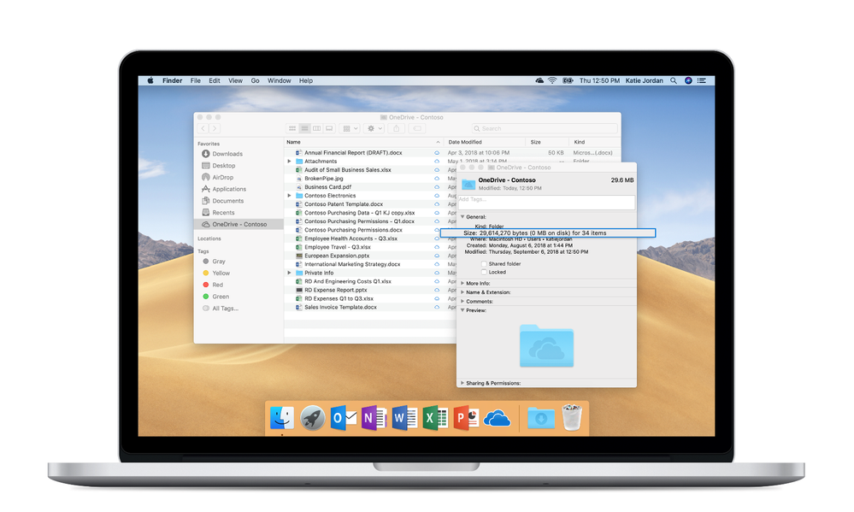
OneDrive for Mac
Files on-demand
Unified sync experience across consumer and commercial
Notes:
we announced OneDrive Files On-Demand for Mac, for our consumer and commercial customers, unifying our OneDrive sync experience across both platforms.
lets you view and open all your files inside File Explorer, including those from Microsoft Teams and SharePoint, without taking up space on your device.

Slide 35
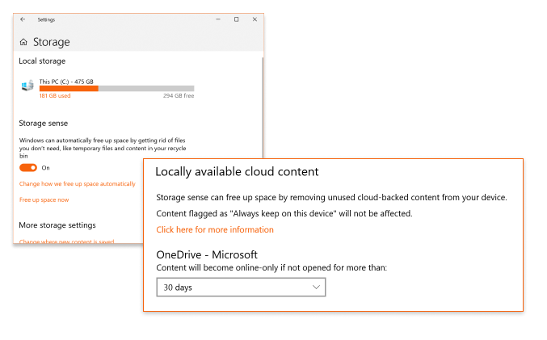
Storage Sense Support
Windows 10
Free up space intelligently based on when content last accessed

Slide 36
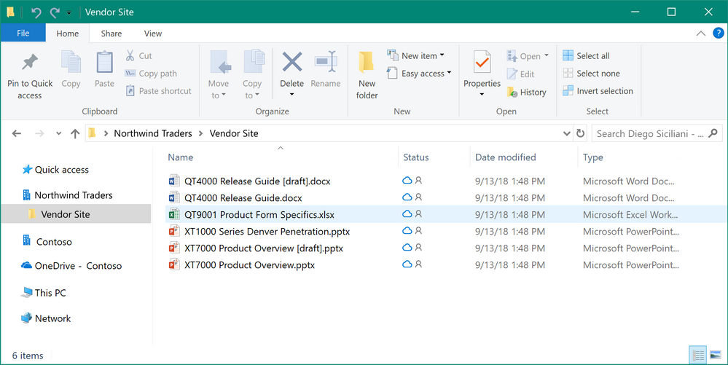
Cross Org Sync
Sync across multiple tenants at the same time

Slide 37
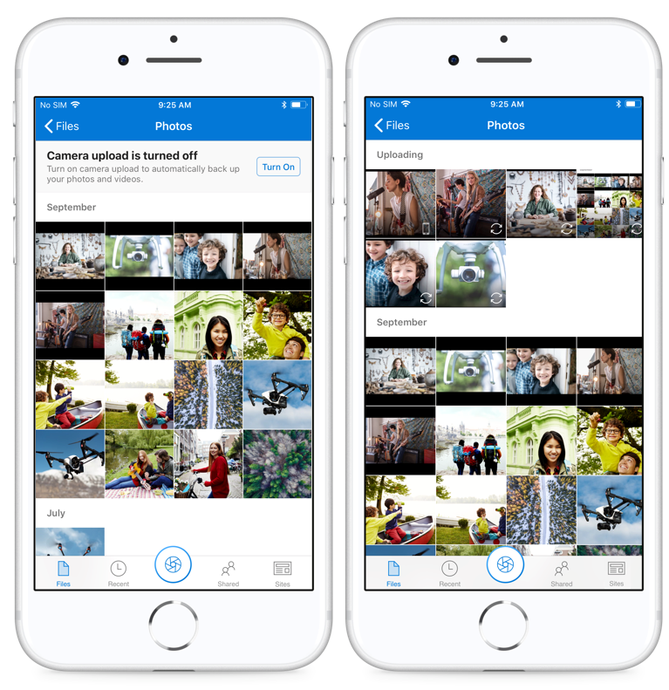
Camera Upload
Automatically upload photos and video taken on device to Camera Roll to OneDrive for Business
Sorted and grouped by Year/Month
Available on iOS
Android in beta
Notes:
OneDrive automatically uploads all photos and videos on the device Camera Roll to the selected OneDrive for Business account. These photos and videos are automatically sorted and grouped by year and month under the “Camera Roll” folder automatically created in the “Pictures” folder.

Slide 38
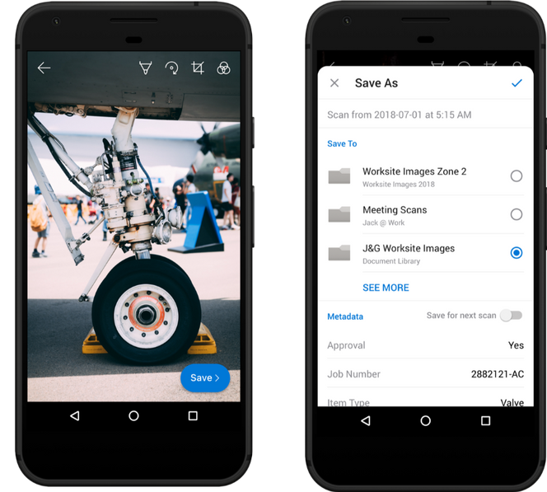
Capture Metadata
Select document library
Add metadata to scanned document/picture
Notes:
when saving a scanned document or image to a site document library, users will be able to add metadata on that document or image. The metadata will be uploaded – along with the document or image – to the selected document library. This capability helps unlock potential new uses cases and workflows right from your phone.
iOS and Android

Slide 39
SharePoint/Teams
Integration

Slide 40
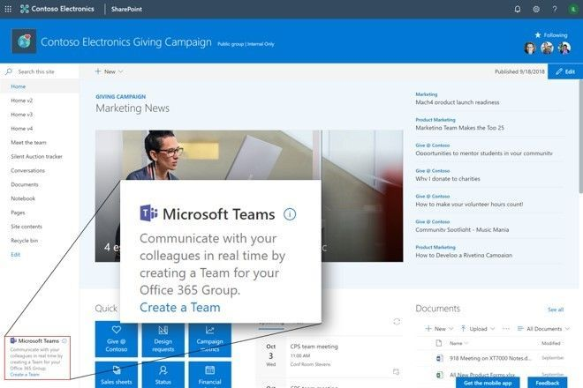
Create Team from Team Site
New Create a Team button
For group connected SharePoint team site
Where a MS Teams team doesn’t exist
Notes:
Create a Team connected to your group-connected SharePoint team site - If your group-connected team site is not connected to a chat-based hub for teamwork, then it’s just one click away with the new Create a Team button in bottom-left corner of your site.

Slide 41
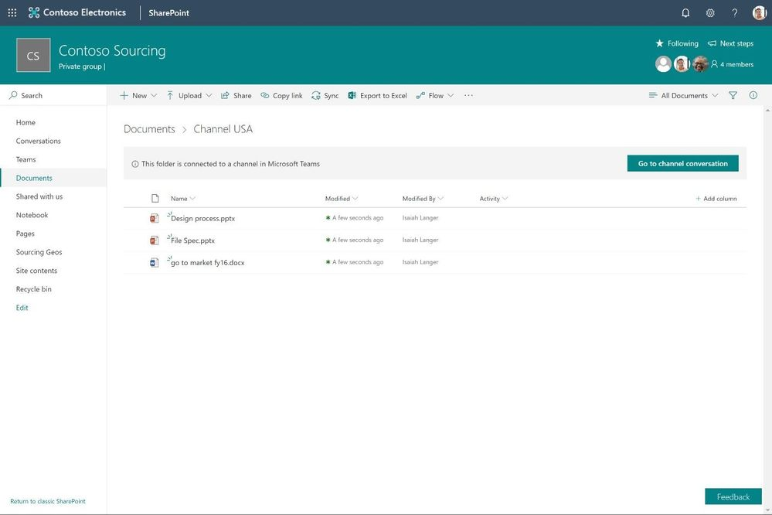
Document library folders visibly connected to Teams channel
Easy to see which folders have associated Teams channel
Link directly to the Teams channel
May provide guidance that delete/rename has to happen via Teams ☺
Notes:
Document library folders in sites visibly connected to Teams channel – Now it’s easy to tell which folders within your library have an associated Teams channel. That means the chat capability associated to it is visible and actionable right from within the SharePoint user interface. SharePoint also helps users understand that some actions, like delete or rename of a channel-connected folder, need to happen through the Teams app.

Slide 42
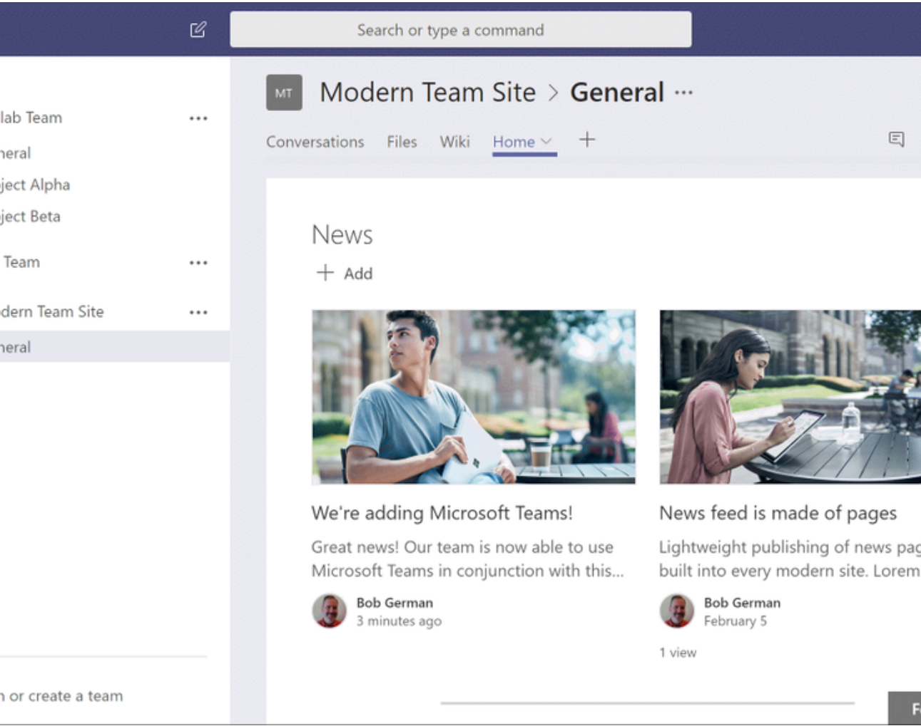
Shared Webpart/Tab Development Model
Use SharePoint webparts (including configuration options) directly in as a custom tab in Teams
Use Teams custom tabs (including configuration options) as a full page app in SharePoint
Notes:
SharePoint web parts as tabs in Teams – We’re working towards directly exposing SharePoint web parts as tabs in Microsoft Teams - including their configuration options. Now, your custom development can be used in more places throughout your organizations collaboration and communication efforts.
Teams connectors as SharePoint web parts for pages and news – We’re working towards directly exposing Teams tabs as full-page apps in SharePoint - including their configuration options. Now your SharePoint sites can take full advantage of the rich ecosystem of service providers who are building integration with Microsoft Teams.

Slide 43
SharePoint Server

Slide 44

SharePoint Server 2019
General Availability October 2018
Modern user experiences
SharePoint framework
OneDrive files on-demand
Enhanced SharePoint migration tool (allows migration of complete site)
Notes:
For our on-premises customers we announced SharePoint Server 2019 will be generally available this October, offering modern user experiences, support for the SharePoint Framework and OneDrive Files On-Demand, along with improved hybrid integration with Office 365. As these organizations continue their cloud journey to get the latest innovations and best security, at a lower TCO, they can take advantage of the free SharePoint Migration Tool that now allows you to move complete on-premises SharePoint sites in addition to data from libraries, lists and file shares.

Slide 45
Stay in touch
Twitter: @CameronDwyer
Blog: camerondwyer.com

